Slide 1

Palaeogeography
dowdingem@gmail.com

Slide 2
Building a Deep Time Earth
Part 1: Plate tectonics
Refresher
Part 2: Plate reference frames
What frame, why and what data
Part 3: Picking your plate
Palaeontology and Palaeomagentics
Area relationships, and model matters for end users

Slide 3

Building deep time earth: A Devonian Example

Slide 4
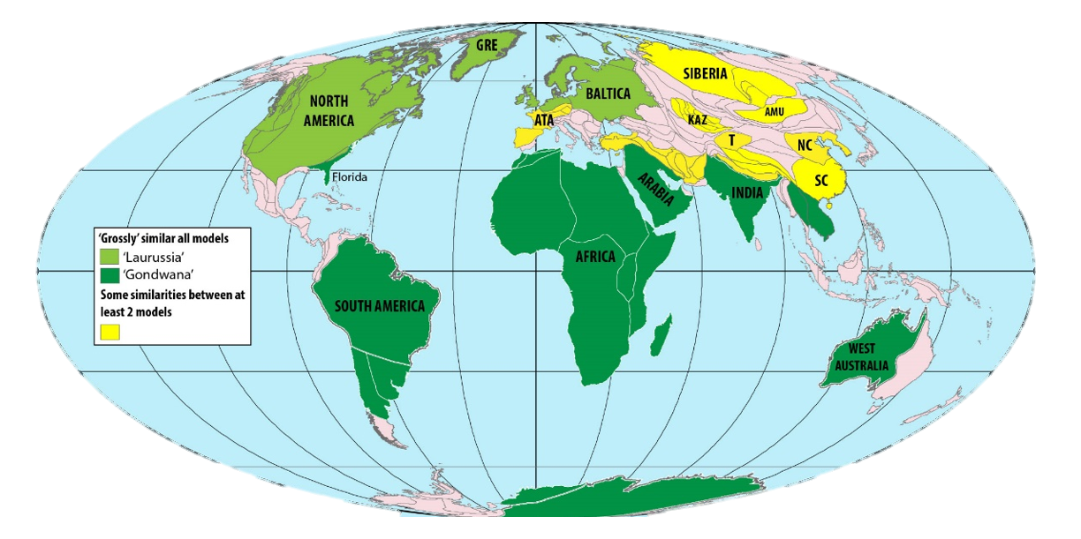
Modern Earth: outcrop and agreement

Slide 5
Modern Earth: outcrop and agreement

Slide 6
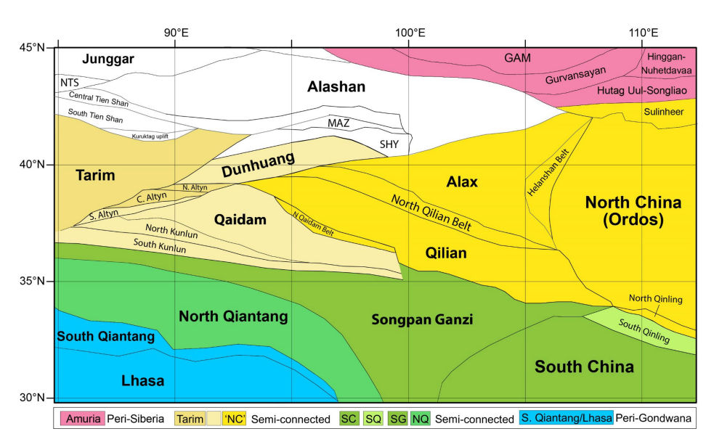

Slide 7
What do I need?
Mantle Theory
Palaeomagentics
True Polar Wander phase
GAD cycle
Rock type
Environmental, latitudinal (for sedimentary)
Type and morphology of igneous material (e.g. Dyke swarms, kimberlites(?) )
Slab dynamics
Rates
Phase (orogeny, subduction)
Age
Fossils

Slide 8
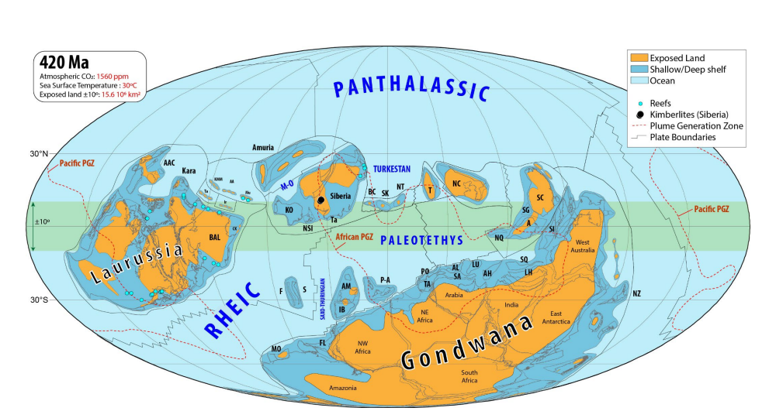
The Devonian Revised
1
Torsvik, Dowding et al

Slide 9
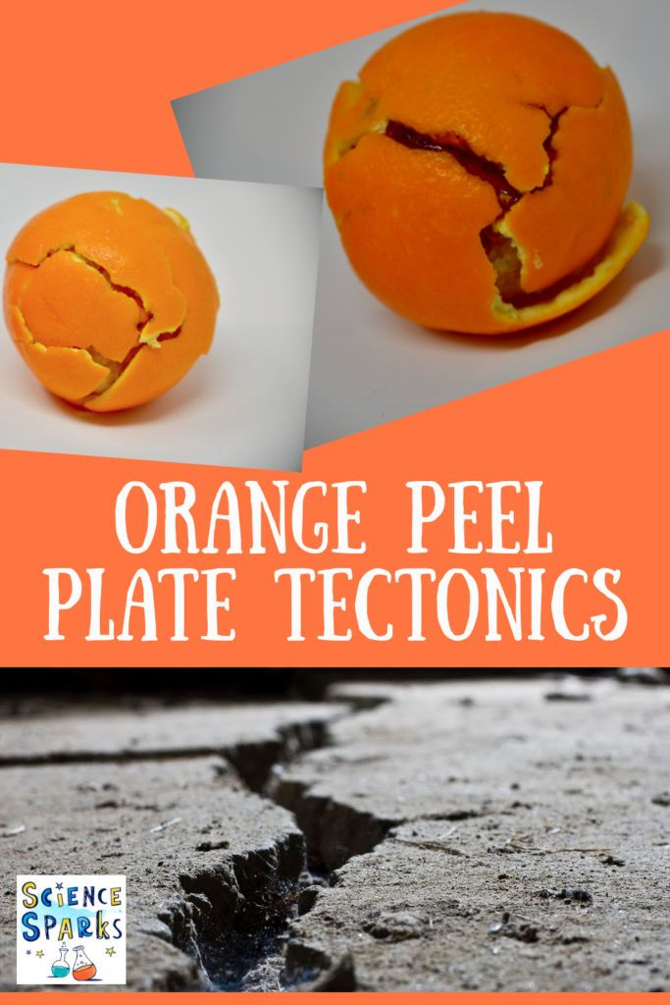

Slide 10
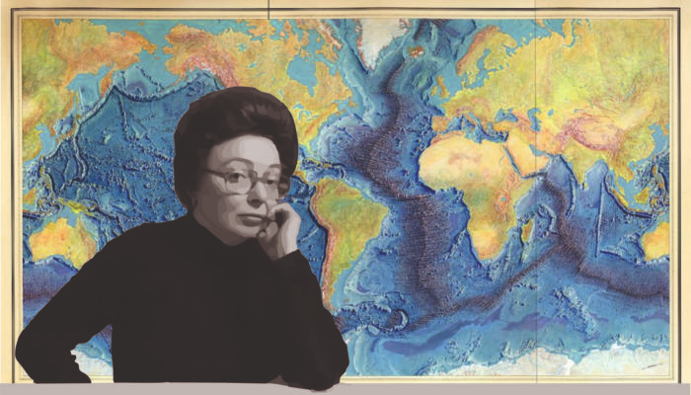
Notes:
GeoLog | Marie Tharp: an inspiration for the past, present and future! (egu.eu)

Slide 11
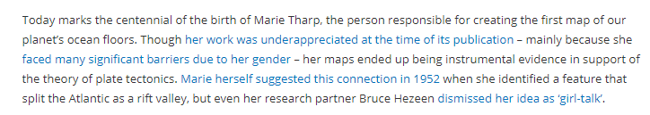
Notes:
GeoLog | Marie Tharp: an inspiration for the past, present and future! (egu.eu)

Slide 12
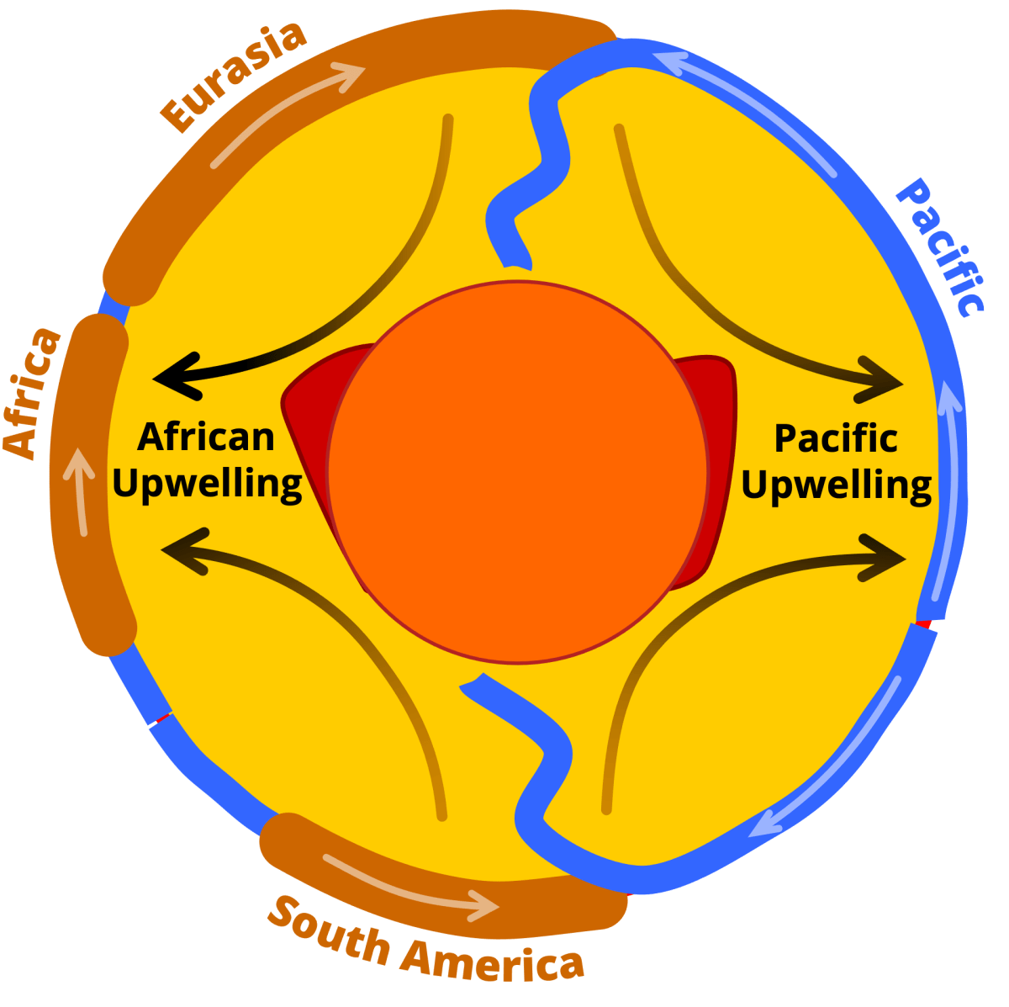
Notes:
A sketch outlining the link between the viscous convection within the Earth’s mantle and tectonic surface plate motions, deforming Earth’s surface across wide areas. Shown are the relative positions and motion of some of Earth’s continental (brown) and oceanic plates (blue) captured by the hypothetical cross-section through the middle of the planet. The dynamic link between surface and mantle motion is highlighted by arrows representing first-order material flow direction. This global-scale mantle flow is believed to also affect the shape, position and mobility of large low shear-velocity provinces (LLSVPs; red) at the base of the mantle (yellow) just above the Earth’s core (orange).
Creator: Clint P. Conrad
This version: 01.09.2021
License: Attribution-ShareAlike 4.0 International (CC BY-SA 4.0)
Specific citation: This graphic by Clint Conrad based on Conrad et al. (2013) is available via the open-access s-Ink repository.
Related reference: Conrad, C., Steinberger, B. & Torsvik, T. Stability of active mantle upwelling revealed by net characteristics of plate tectonics. Nature 498, 479–482 (2013). https://doi.org/10.1038/nature12203

Slide 13

The Wilson Cycle
How to make and unmake Pangea
Notes:
The birth of ocean basins

Slide 14
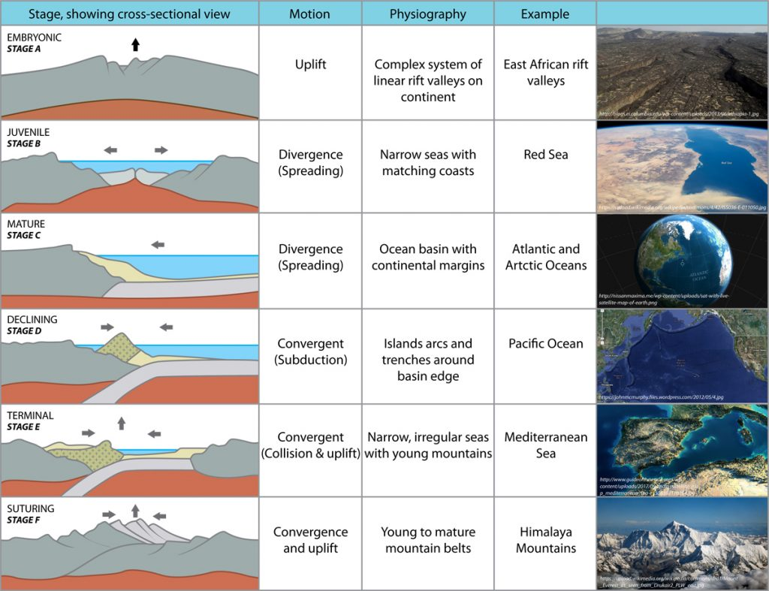

Slide 15
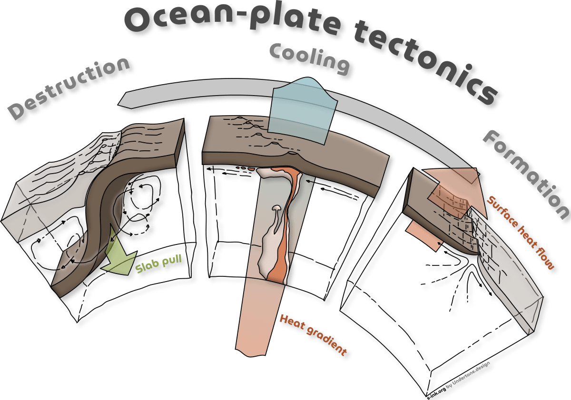
Notes:
A schematic highlighting the ocean-plate formation, cooling and destruction as part of the planet’s global mantle convection driven by the temperature gradient between its hot deep interior and the cold surface environment. Ocean-Plate Tectonics is the concept that describes not only the horizontal surface motion of the oceanic plate (grey arrow), but also highlights the pull from its subducted portion as the main driver (green arrow), distinguishes the oceanic plate (dark brown) from its continental counterpart, acknowledges the plate–mantle coupling that induces characteristic regional mantle-flow patterns (black flow lines), and describes the dynamics of the oceanic plate as part of the larger framework of global mantle convection that transports heat out of the interior (light-red arrow) due to the heat gradient between the planetary interior and outer space.
Creator: Fabio Crameri
This version: 22.09.2022
License: Attribution-ShareAlike 4.0 International (CC BY-SA 4.0)
Specific citation: This graphic by Fabio Crameri from Crameri et al. (2019) is available via the open-access s-Ink.org repository.
Related reference: Crameri, F., C.P. Conrad, L. Montési, and C.R. Lithgow-Bertelloni (2019), The dynamic life of an oceanic plate, Tectonophysics, 760, 107-135, doi:10.1016/j.tecto.2018.03.016

Slide 16
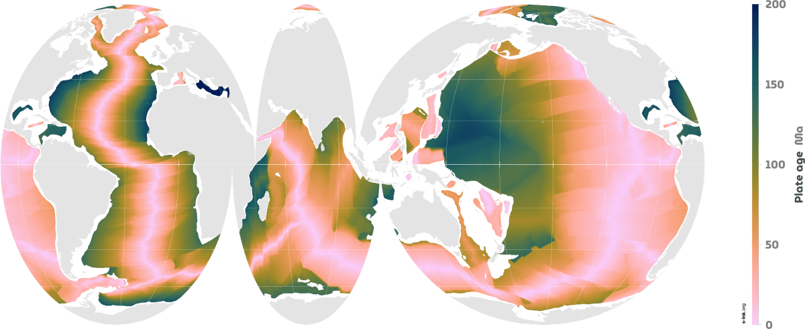
Ocean-plate age
Notes:
Maps of the age of oceanic plates, which varies between 0 and around 200 Ma due to ongoing plate motion and recycling (i.e., ocean-plate tectonics). Global ocean-plate age data from Müller et al. (1997) visualised on a custom Interrupted Mollweide map projection from Crameri et al. (2020) focussing on the World’s oceans. The Scientific colour map ‘batlow‘ is used to represent data accurately and to all readers.
Creator: Fabio Crameri
This version: 20.08.2021
License: Attribution-ShareAlike 4.0 International (CC BY-SA 4.0)
Specific citation: This graphic by Fabio Crameri from Crameri et al. (2022) is available via the open-access s-Ink.org repository.
Related references: Crameri, F., G.E. Shephard, and E.O. Straume (2022, Pre-print), Effective high-quality science graphics from s-Ink.org, EarthArXiv, https://doi.org/10.31223/X51P78 Müller, R. D., et al. (1997). “Digital isochrons of the world’s ocean floor.” J. Geophys. Res. 102(B2): 3211-3214. Crameri, F., V. Magni, M. Domeier, G.E. Shephard, K. Chotalia, G. Cooper, C. Eakin, A.G. Grima, D. Gürer, A. Király, E. Mulyukova, K. Peters, B. Robert, and M. Thielmann (2020), A transdisciplinary and community-driven database to unravel subduction zone initiation, Nature Communications, 11, 3750. doi:10.1038/s41467-020-17522-9

Slide 17
Ocean-plate age
Notes:
Maps of the age of oceanic plates, which varies between 0 and around 200 Ma due to ongoing plate motion and recycling (i.e., ocean-plate tectonics). Global ocean-plate age data from Müller et al. (1997) visualised on a custom Interrupted Mollweide map projection from Crameri et al. (2020) focussing on the World’s oceans. The Scientific colour map ‘batlow‘ is used to represent data accurately and to all readers.
Creator: Fabio Crameri
This version: 20.08.2021
License: Attribution-ShareAlike 4.0 International (CC BY-SA 4.0)
Specific citation: This graphic by Fabio Crameri from Crameri et al. (2022) is available via the open-access s-Ink.org repository.
Related references: Crameri, F., G.E. Shephard, and E.O. Straume (2022, Pre-print), Effective high-quality science graphics from s-Ink.org, EarthArXiv, https://doi.org/10.31223/X51P78 Müller, R. D., et al. (1997). “Digital isochrons of the world’s ocean floor.” J. Geophys. Res. 102(B2): 3211-3214. Crameri, F., V. Magni, M. Domeier, G.E. Shephard, K. Chotalia, G. Cooper, C. Eakin, A.G. Grima, D. Gürer, A. Király, E. Mulyukova, K. Peters, B. Robert, and M. Thielmann (2020), A transdisciplinary and community-driven database to unravel subduction zone initiation, Nature Communications, 11, 3750. doi:10.1038/s41467-020-17522-9

Slide 18
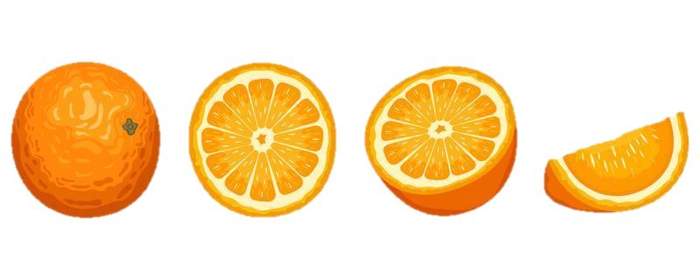
But how does this all happen?

Slide 19
Mantle convection (mobile-lid)
Notes:
Movie showing the temporal evolution of a global, fully spherical, 3D model of whole-mantle convection with hot temperature isosurface (red) and stiff viscosity isosurfaces (grey).
Creator: Fabio Crameri
This version: 07.08.2021
License: Attribution-ShareAlike 4.0 International (CC BY-SA 4.0)
Specific citation: This graphic by Fabio Crameri from Crameri and Tackley (2016) is available via the open-access s-Ink.org repository.
Related reference: Crameri, F., and P. J. Tackley (2016), Subduction initiation from a stagnant lid and global overturn: new insights from numerical models with a free surface, Progress in Earth and Planetary Science, 3(1), 1–19, doi:10.1186/s40645-016-0103-8

Slide 20
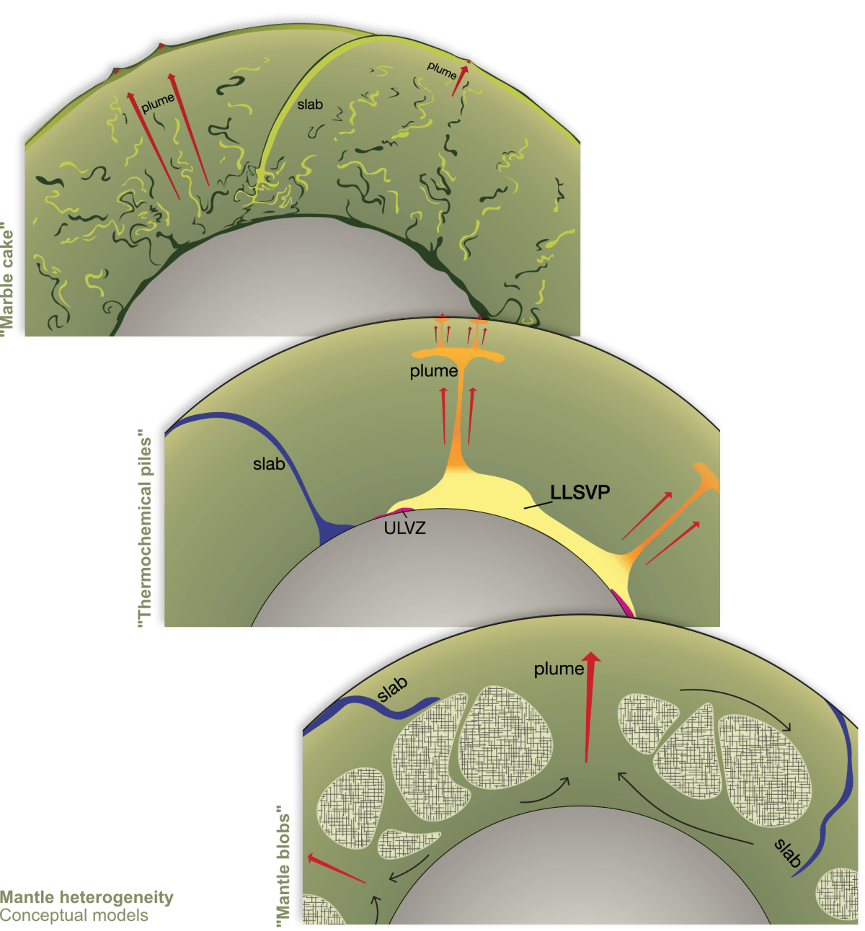
Earth’s mantle heterogeneity theories
Notes:
Creator: Anna Gülcher
This version: 17.12.2022
License: Attribution-ShareAlike 4.0 International (CC BY-NC-SA 4.0)
Specific citation: These graphics by Anna Gülcher from Gülcher et al. (2021) are available via the open-access s-Ink.org repository.
Related reference: Gülcher, A. J. P., Ballmer, M. D., and Tackley, P. J. (2021), Coupled dynamics and evolution of primordial and recycled heterogeneity in Earth’s lower mantle, Solid Earth, 12, 2087–2107, 2021 https://doi.org/10.5194/se-12-2087-2021

Slide 21
Earth’s mantle heterogeneity theories
Notes:
Creator: Anna Gülcher
This version: 17.12.2022
License: Attribution-ShareAlike 4.0 International (CC BY-NC-SA 4.0)
Specific citation: These graphics by Anna Gülcher from Gülcher et al. (2021) are available via the open-access s-Ink.org repository.
Related reference: Gülcher, A. J. P., Ballmer, M. D., and Tackley, P. J. (2021), Coupled dynamics and evolution of primordial and recycled heterogeneity in Earth’s lower mantle, Solid Earth, 12, 2087–2107, 2021 https://doi.org/10.5194/se-12-2087-2021

Slide 22
Earth’s mantle heterogeneity theories
Notes:
Creator: Anna Gülcher
This version: 17.12.2022
License: Attribution-ShareAlike 4.0 International (CC BY-NC-SA 4.0)
Specific citation: These graphics by Anna Gülcher from Gülcher et al. (2021) are available via the open-access s-Ink.org repository.
Related reference: Gülcher, A. J. P., Ballmer, M. D., and Tackley, P. J. (2021), Coupled dynamics and evolution of primordial and recycled heterogeneity in Earth’s lower mantle, Solid Earth, 12, 2087–2107, 2021 https://doi.org/10.5194/se-12-2087-2021

Slide 23
Earth’s mantle heterogeneity theories
Notes:
Creator: Anna Gülcher
This version: 17.12.2022
License: Attribution-ShareAlike 4.0 International (CC BY-NC-SA 4.0)
Specific citation: These graphics by Anna Gülcher from Gülcher et al. (2021) are available via the open-access s-Ink.org repository.
Related reference: Gülcher, A. J. P., Ballmer, M. D., and Tackley, P. J. (2021), Coupled dynamics and evolution of primordial and recycled heterogeneity in Earth’s lower mantle, Solid Earth, 12, 2087–2107, 2021 https://doi.org/10.5194/se-12-2087-2021

Slide 24
Earth’s mantle heterogeneity theories
Notes:
Creator: Anna Gülcher
This version: 17.12.2022
License: Attribution-ShareAlike 4.0 International (CC BY-NC-SA 4.0)
Specific citation: These graphics by Anna Gülcher from Gülcher et al. (2021) are available via the open-access s-Ink.org repository.
Related reference: Gülcher, A. J. P., Ballmer, M. D., and Tackley, P. J. (2021), Coupled dynamics and evolution of primordial and recycled heterogeneity in Earth’s lower mantle, Solid Earth, 12, 2087–2107, 2021 https://doi.org/10.5194/se-12-2087-2021

Slide 25
Earth’s mantle heterogeneity theories
Notes:
Creator: Anna Gülcher
This version: 17.12.2022
License: Attribution-ShareAlike 4.0 International (CC BY-NC-SA 4.0)
Specific citation: These graphics by Anna Gülcher from Gülcher et al. (2021) are available via the open-access s-Ink.org repository.
Related reference: Gülcher, A. J. P., Ballmer, M. D., and Tackley, P. J. (2021), Coupled dynamics and evolution of primordial and recycled heterogeneity in Earth’s lower mantle, Solid Earth, 12, 2087–2107, 2021 https://doi.org/10.5194/se-12-2087-2021

Slide 27
Large Low-Shear-Velocity Province
3% slower than the rest of the mantle
Thermochemical piles: near antipodal and equatorial.
Their edges are ‘plume generation zones’ and can impact the Wilson cycle.
LLSVPs are thermal insulator, making core heating effective at their edges for mantle plumes.
Notes:
Origin of the LLSVPs at the base of the mantle is a consequence of plate tectonics – A petrological and geochemical perspective - ScienceDirect

Slide 28
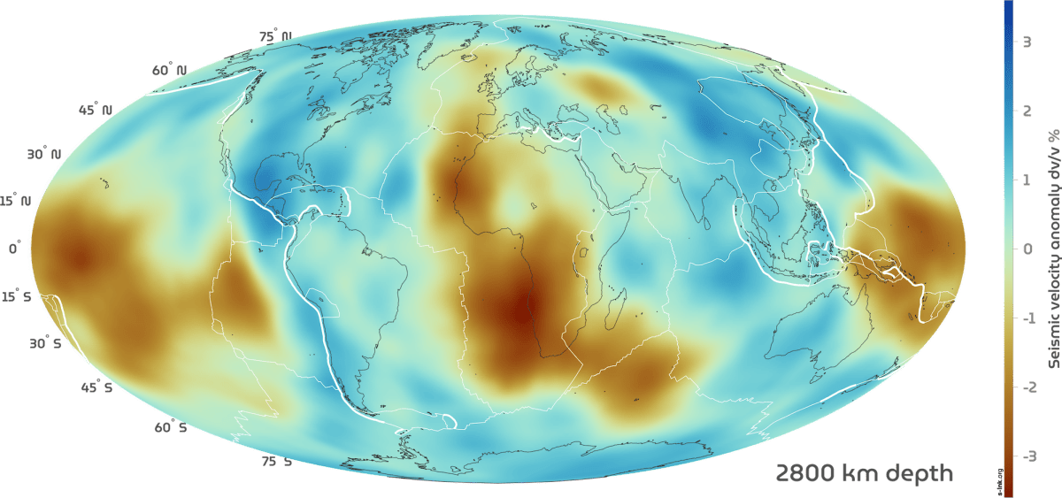
Seismic mantle tomography maps
Notes:
Surface projected global horizontal seismic S-wave velocity anomaly maps for different mantle depths revealing the two large low shear-wave velocity provinces (LLSVPs) below the Pacific (named Jason) and Africa (named Tuzo). Shown is the S10MEAN model based on Doubrovine et al. (2016) averaging 10 tomography models allowing to compare relative variations in S-wave velocity. The Scientific colour map ‘batlow‘ is used to represent data accurately and to all readers.
Creator: Fabio Crameri
This version: 31.10.2021
License: Attribution-ShareAlike 4.0 International (CC BY-SA 4.0)
Specific citation: This graphic by Fabio Crameri based on data compiled by Doubrovine et al. (2016) is available via the open-access s-Ink repository.
Related references: Doubrovine, P. V., Steinberger, B., and Torsvik, T. H. (2016), A failure to reject: Testing the correlation between large igneous provinces and deep mantle structures with EDF statistics, Geochem. Geophys. Geosyst., 17, 1130– 1163, doi:10.1002/2015GC006044.

Slide 29
Seismic mantle tomography maps
Jason
Jason
Tuzo
Notes:
Surface projected global horizontal seismic S-wave velocity anomaly maps for different mantle depths revealing the two large low shear-wave velocity provinces (LLSVPs) below the Pacific (named Jason) and Africa (named Tuzo). Shown is the S10MEAN model based on Doubrovine et al. (2016) averaging 10 tomography models allowing to compare relative variations in S-wave velocity. The Scientific colour map ‘batlow‘ is used to represent data accurately and to all readers.
Creator: Fabio Crameri
This version: 31.10.2021
License: Attribution-ShareAlike 4.0 International (CC BY-SA 4.0)
Specific citation: This graphic by Fabio Crameri based on data compiled by Doubrovine et al. (2016) is available via the open-access s-Ink repository.
Related references: Doubrovine, P. V., Steinberger, B., and Torsvik, T. H. (2016), A failure to reject: Testing the correlation between large igneous provinces and deep mantle structures with EDF statistics, Geochem. Geophys. Geosyst., 17, 1130– 1163, doi:10.1002/2015GC006044.

Slide 30
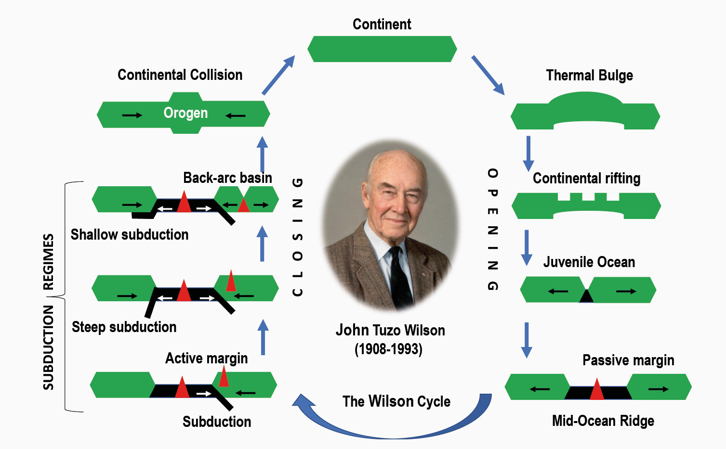

Slide 31
Notes:
A sketch outlining the link between the viscous convection within the Earth’s mantle and tectonic surface plate motions, deforming Earth’s surface across wide areas. Shown are the relative positions and motion of some of Earth’s continental (brown) and oceanic plates (blue) captured by the hypothetical cross-section through the middle of the planet. The dynamic link between surface and mantle motion is highlighted by arrows representing first-order material flow direction. This global-scale mantle flow is believed to also affect the shape, position and mobility of large low shear-velocity provinces (LLSVPs; red) at the base of the mantle (yellow) just above the Earth’s core (orange).
Creator: Clint P. Conrad
This version: 01.09.2021
License: Attribution-ShareAlike 4.0 International (CC BY-SA 4.0)
Specific citation: This graphic by Clint Conrad based on Conrad et al. (2013) is available via the open-access s-Ink repository.
Related reference: Conrad, C., Steinberger, B. & Torsvik, T. Stability of active mantle upwelling revealed by net characteristics of plate tectonics. Nature 498, 479–482 (2013). https://doi.org/10.1038/nature12203

Slide 34
North East Atlantic Ocean Evolution
Notes:
Opening of the North East Atlantic Ocean and dynamic support from the Iceland mantle plume. The Scientific colour maps ‘oleron’ and lajolla‘ is used to represent data accurately and to all readers.
Creator: Eivind O. Straume
This version: 03.09.2021
License: Attribution-ShareAlike 4.0 International (CC BY-SA 4.0)
Specific citation: This graphic by Eivind O. Straume is available via the open-access s-Ink repository.
Related reference: E.O. Straume, C. Gaina, S. Medvedev, and K.H. Nisancioglu (2020), Global Cenozoic Paleobathymetry with a focus on the Northern Hemisphere Oceanic Gateways, Gondwana Research, 86, 126-143. https://doi.org/10.1016/j.gr.2020.05.011

Slide 35
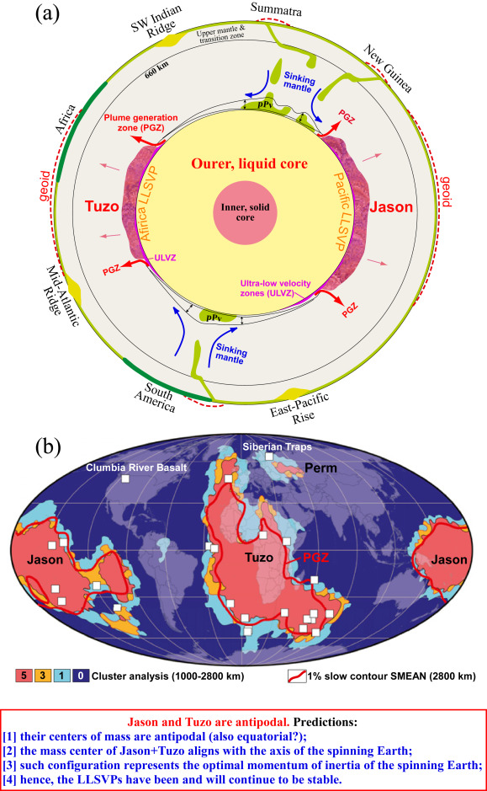
Where, what, and why?
(1) subduction of the ocean crust of basaltic composition (SOC)to the lower mantle is irreversible because SOC is denser than the ambience of peridotitic composition under lower mantle conditions in both solid state and liquid form

Slide 36
Where, what, and why?
subduction of the ocean crust of basaltic composition (SOC)to the lower mantle is irreversible because SOC is denser than the ambience of peridotitic composition under lower mantle conditions in both solid state and liquid form;
SOC is the best candidate for the LLSVPs composition, which are, in turn, the permanent graveyard of SOC.

Slide 37
Where, what, and why?
subduction of the ocean crust of basaltic composition (SOC)to the lower mantle is irreversible because SOC is denser than the ambience of peridotitic composition under lower mantle conditions in both solid state and liquid form;
SOC is the best candidate for the LLSVPs composition, which are, in turn, the permanent graveyard of SOC.
the LLSVPs act as thermal insulators, making core-heating induced mantle diapirs or plumes initiated at their edges, which explains why the large igneous provinces (LIPs) are associated with the edges of the LLSVPs

Slide 38
Where, what, and why?
subduction of the ocean crust of basaltic composition (SOC)to the lower mantle is irreversible because SOC is denser than the ambience of peridotitic composition under lower mantle conditions in both solid state and liquid form;
SOC is the best candidate for the LLSVPs composition, which are, in turn, the permanent graveyard of SOC.
the LLSVPs act as thermal insulators, making core-heating induced mantle diapirs or plumes initiated at their edges, which explains why the large igneous provinces (LIPs) are associated with the edges of the LLSVPs
The antipodal positioning of Jason and Tuzo represents the optimal momentum of inertia, which explains why the LLSVPs are stable in the spinning Earth.

Slide 39
Where, what, and why?
subduction of the ocean crust of basaltic composition (SOC)to the lower mantle is irreversible because SOC is denser than the ambience of peridotitic composition under lower mantle conditions in both solid state and liquid form;
SOC is the best candidate for the LLSVPs composition, which are, in turn, the permanent graveyard of SOC.
the LLSVPs act as thermal insulators, making core-heating induced mantle diapirs or plumes initiated at their edges, which explains why the large igneous provinces (LIPs) are associated with the edges of the LLSVPs
The antipodal positioning of Jason and Tuzo represents the optimal momentum of inertia, which explains why the LLSVPs are stable in the spinning Earth.
EXTREMELY CONTENTIOUS
Notes:
Origin of the LLSVPs at the base of the mantle is a consequence of plate tectonics – A petrological and geochemical perspective - ScienceDirect

Slide 40
Earth’s mantle heterogeneity theories
What effect would each of these have on plate reconstruction? On Earth history?
Notes:
Creator: Anna Gülcher
This version: 17.12.2022
License: Attribution-ShareAlike 4.0 International (CC BY-NC-SA 4.0)
Specific citation: These graphics by Anna Gülcher from Gülcher et al. (2021) are available via the open-access s-Ink.org repository.
Related reference: Gülcher, A. J. P., Ballmer, M. D., and Tackley, P. J. (2021), Coupled dynamics and evolution of primordial and recycled heterogeneity in Earth’s lower mantle, Solid Earth, 12, 2087–2107, 2021 https://doi.org/10.5194/se-12-2087-2021

Slide 41
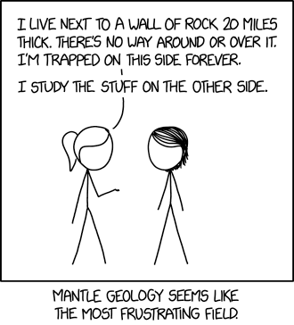

Slide 42
Are they LLSVPs stable? Why does it matter?
Can they be used as latitudinal markers?
The locations of LIPS
The impact on plate motions
The mechanism driving plate tectonics itself.
The debate continues. This is relevant for the TC2019 model and its approach to longitude Torsvik and Cocks 2019

Slide 43
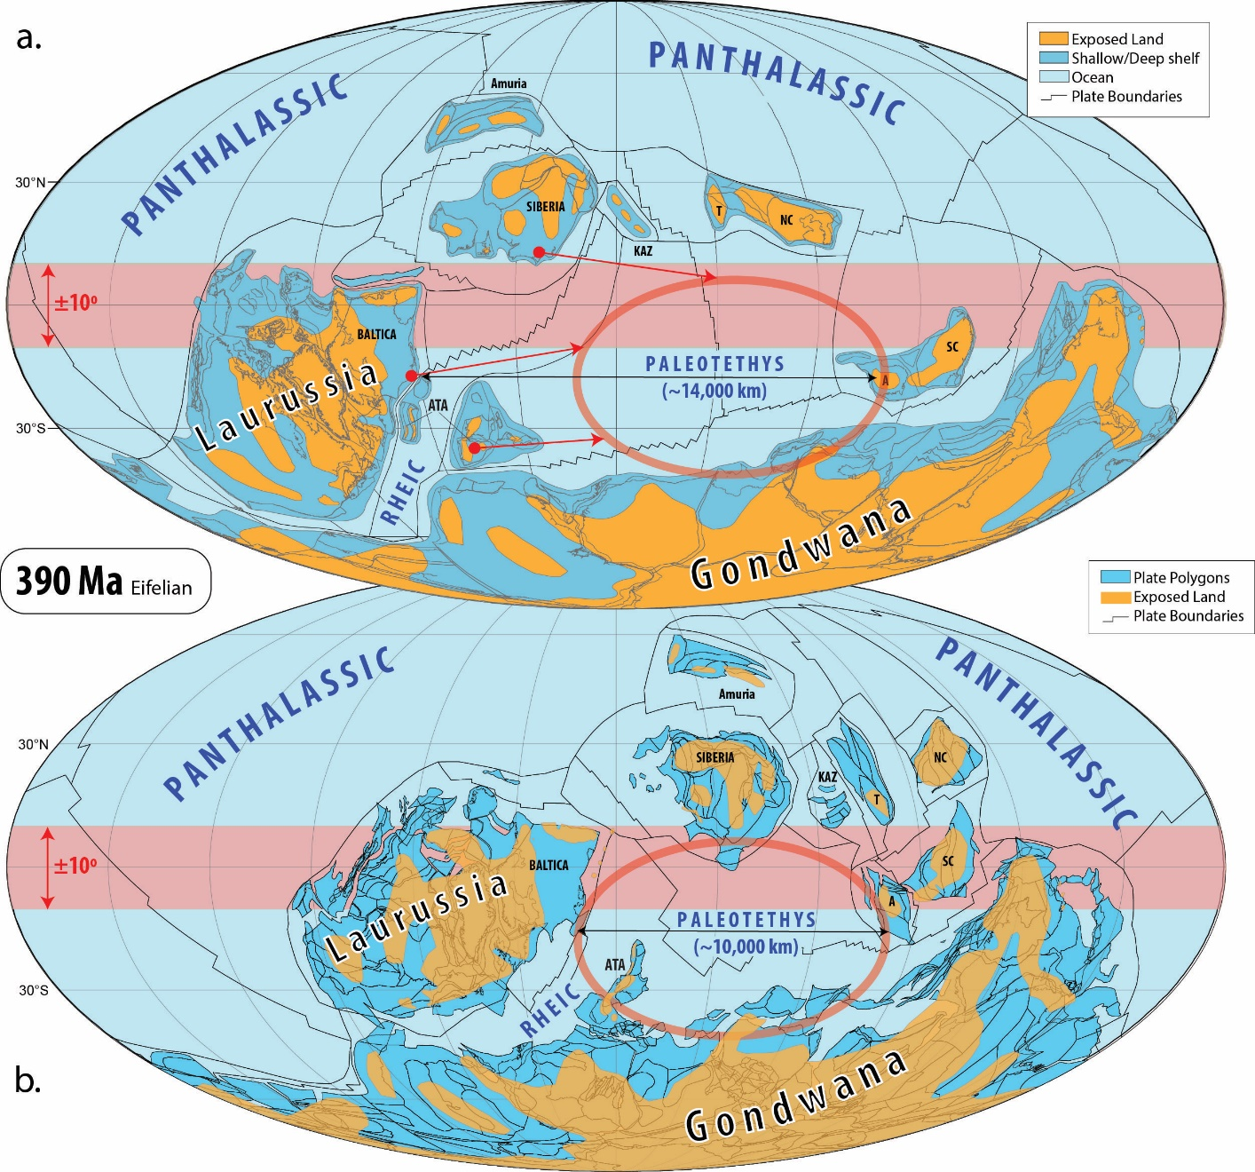

Slide 44
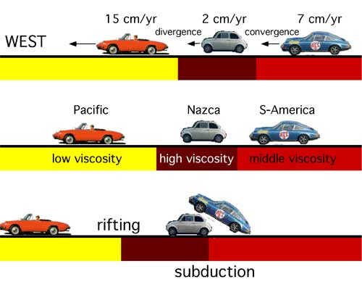
Relative plate velocities
Notes:
http://www.mantleplumes.org/Hotspots.html

Slide 45
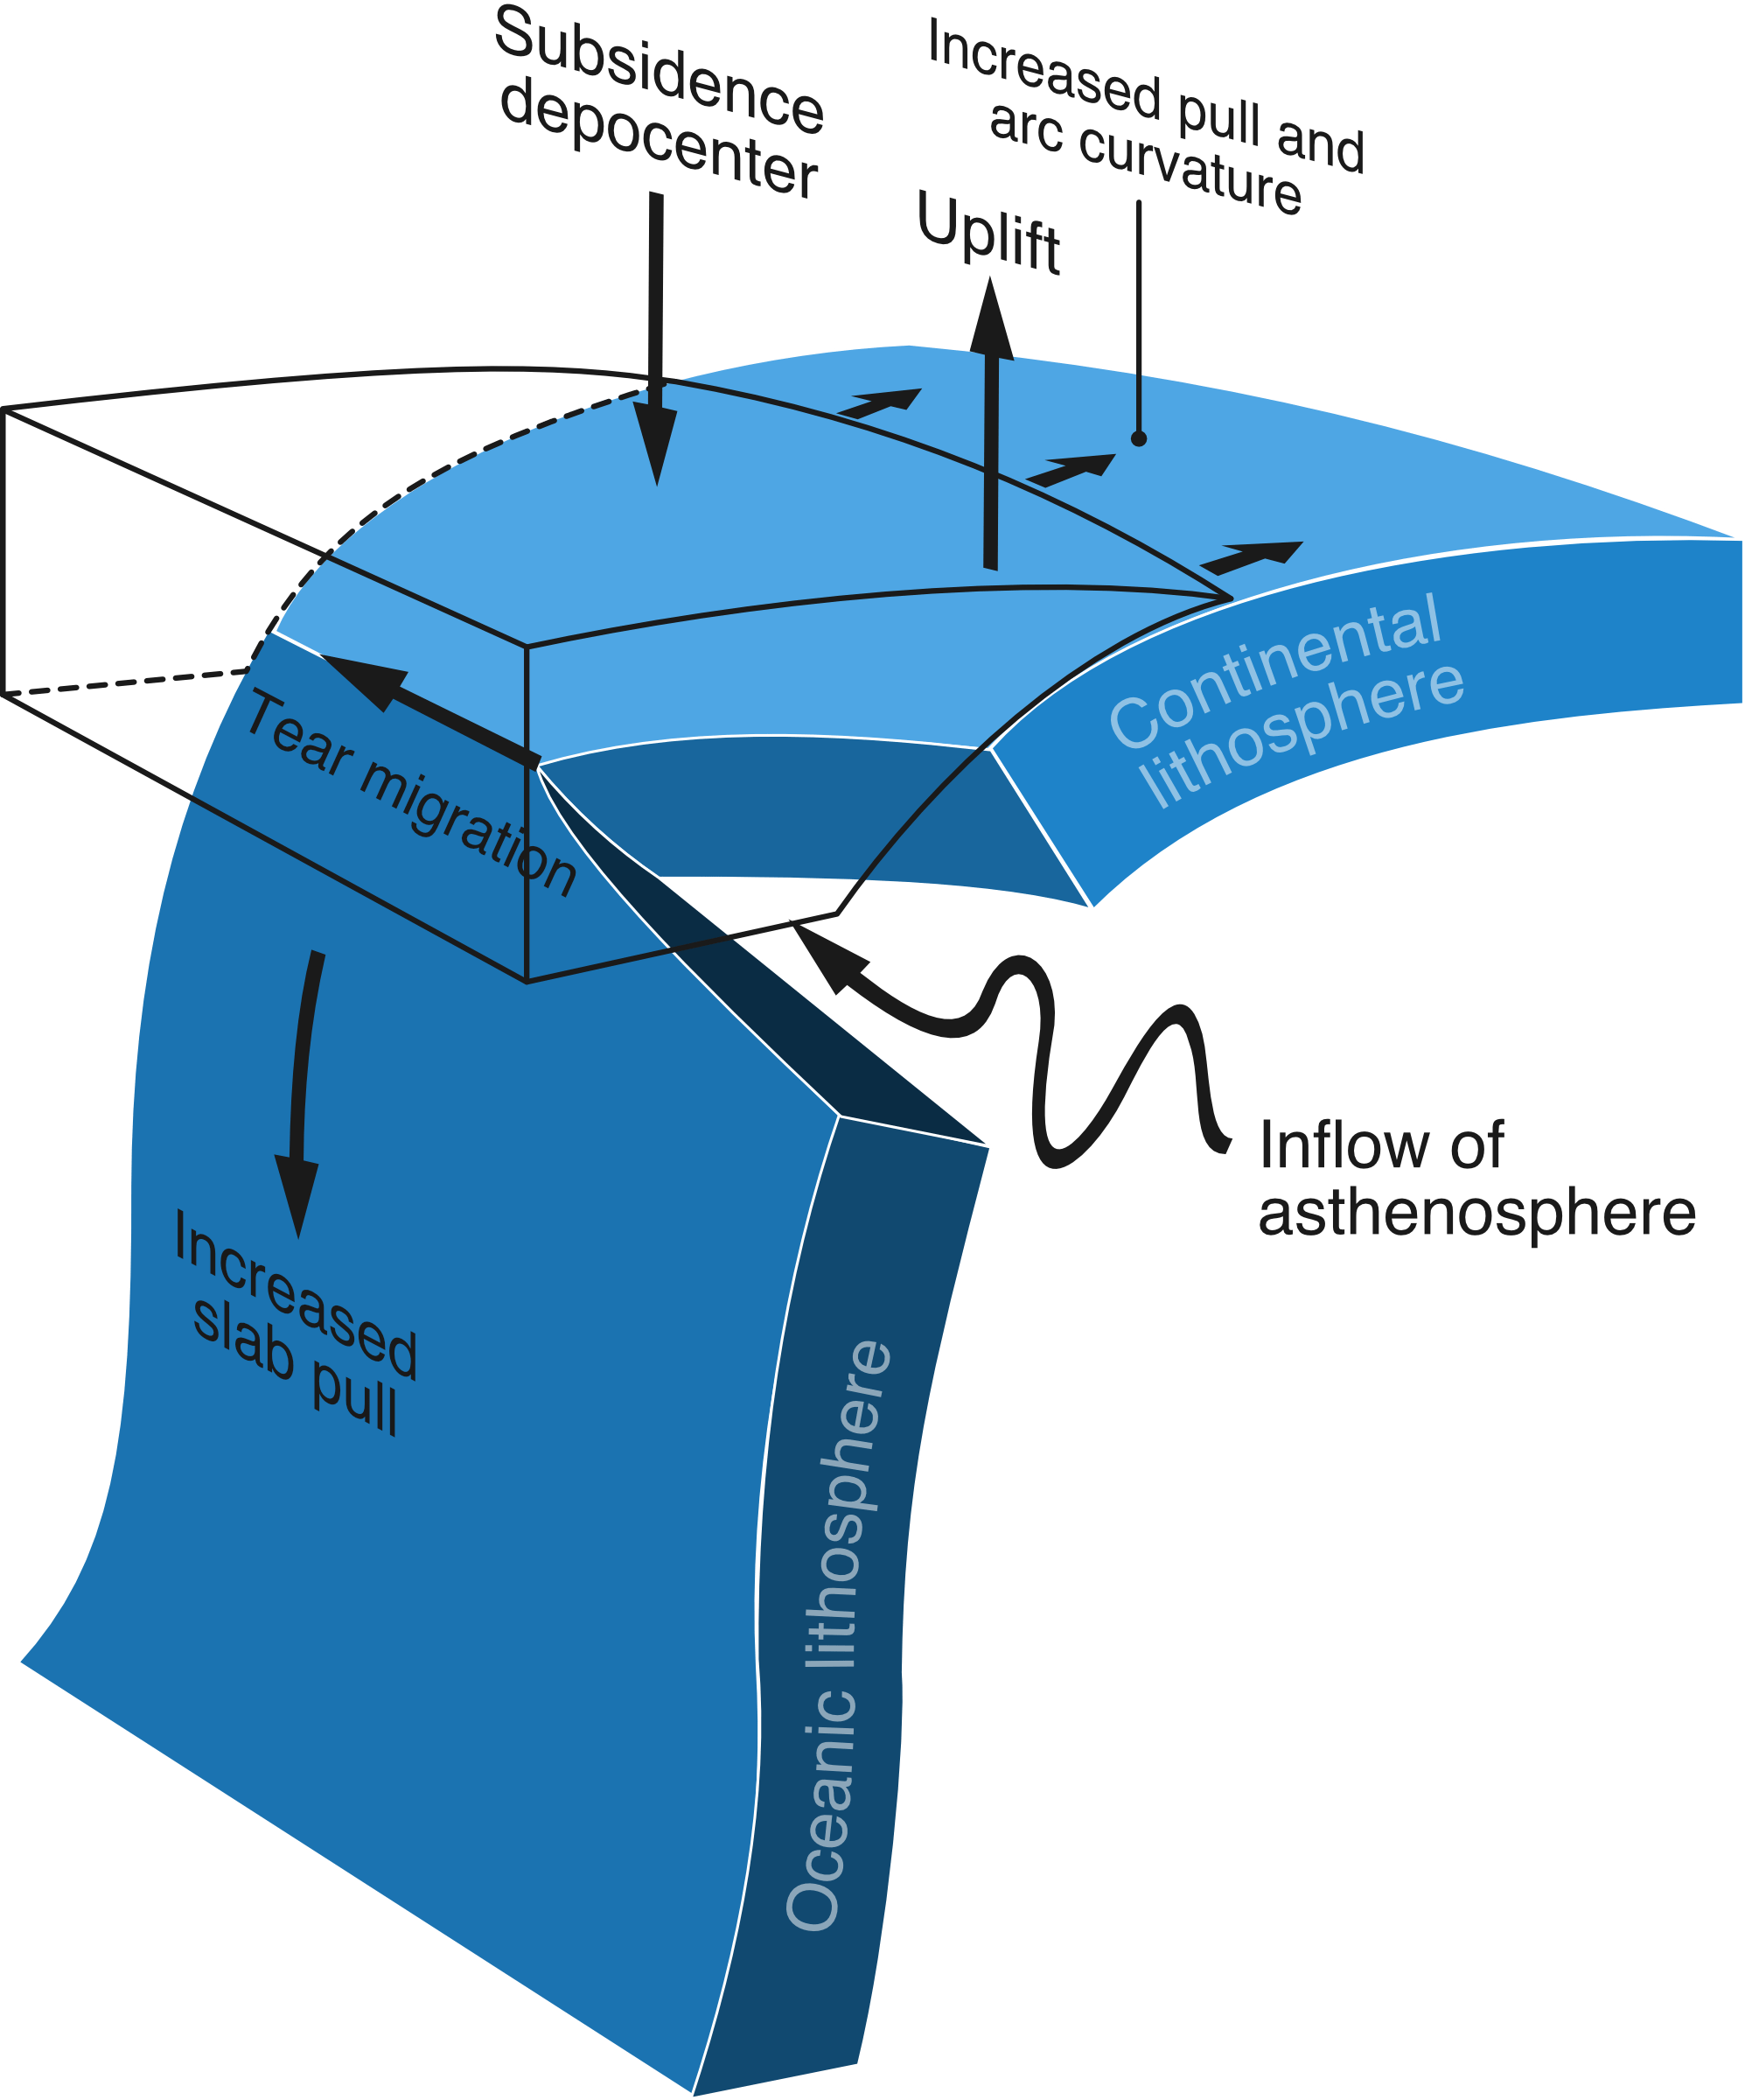
Plate rates of movement
Notes:
Slab rollback

Slide 46
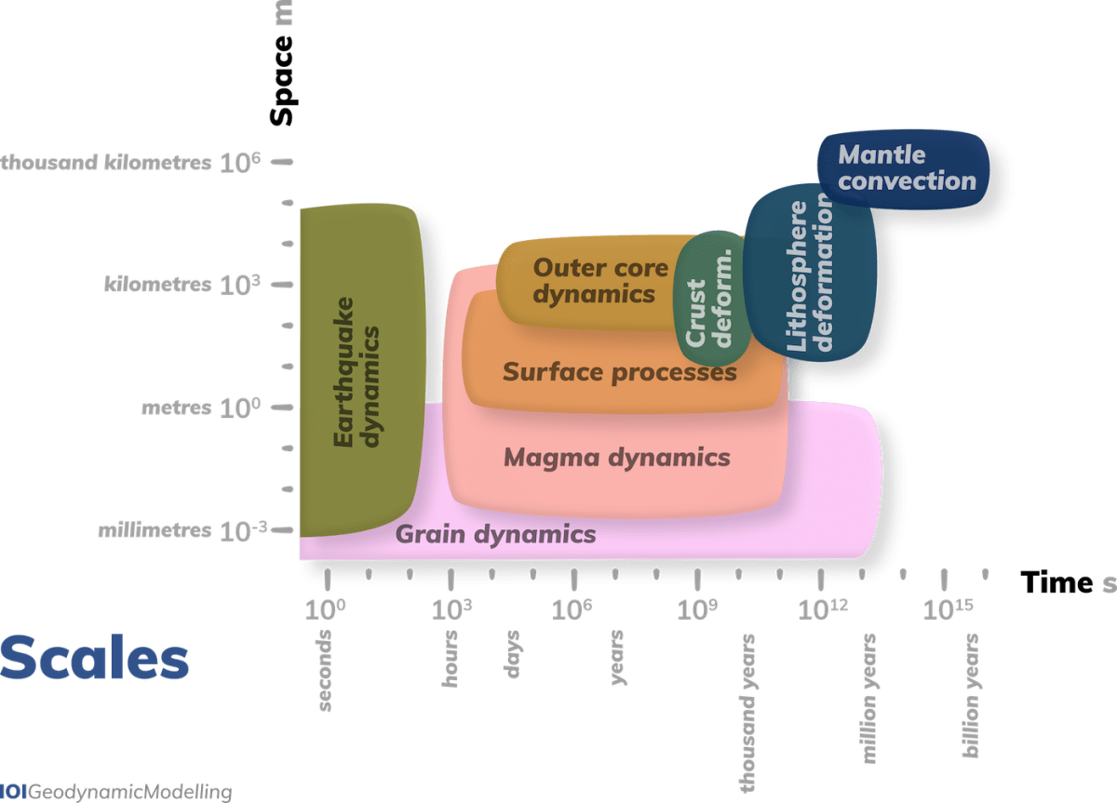
Geodynamic scales and evidence
Notes:
Spatial and temporal scales of common geodynamic processes, which occur over a wide range of time and length scales. The Scientific colour map ‘batlow‘ is used to represent individual processes to all readers.
Creator: Fabio Crameri
This version: 07.09.2021
License: Attribution-ShareAlike 4.0 International (CC BY-SA 4.0)
Specific citation: This graphic by Fabio Crameri from van Zelst et al. (2021) is available via the open-access s-Ink repository.
Related reference: van Zelst, I., F. Crameri, A.E. Pusok, A.C. Glerum, J. Dannberg, C. Thieulot (2021, in review), 101 Geodynamic modelling: How to design, carry out, and interpret numerical studies, Solid Earth Discuss. [preprint], doi:10.5194/se-2021-14

Slide 47
Part 2: Reference Frames
Palaeomag
Hotspot
Mantle

Slide 48
Palaeomag

Slide 49
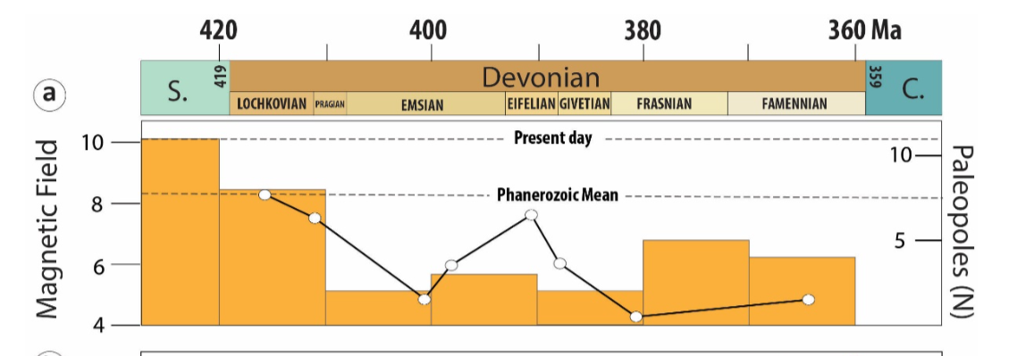

Slide 50
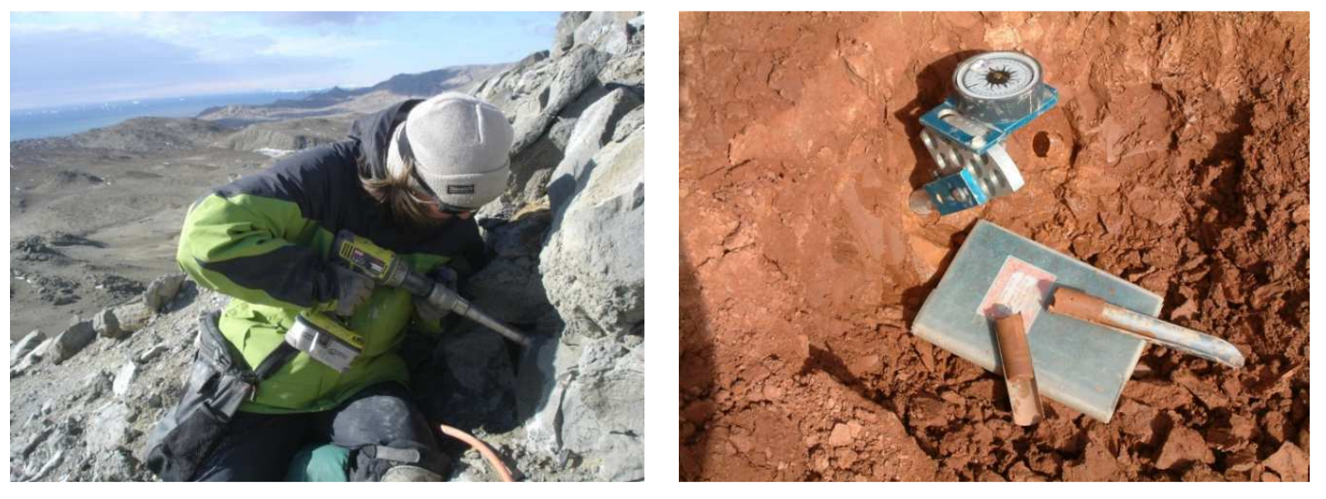
Where does the data come from?
Notes:
08-Paleomagnetism principles and applications - Bet Beamund_ed2 (ub.edu)

Slide 51
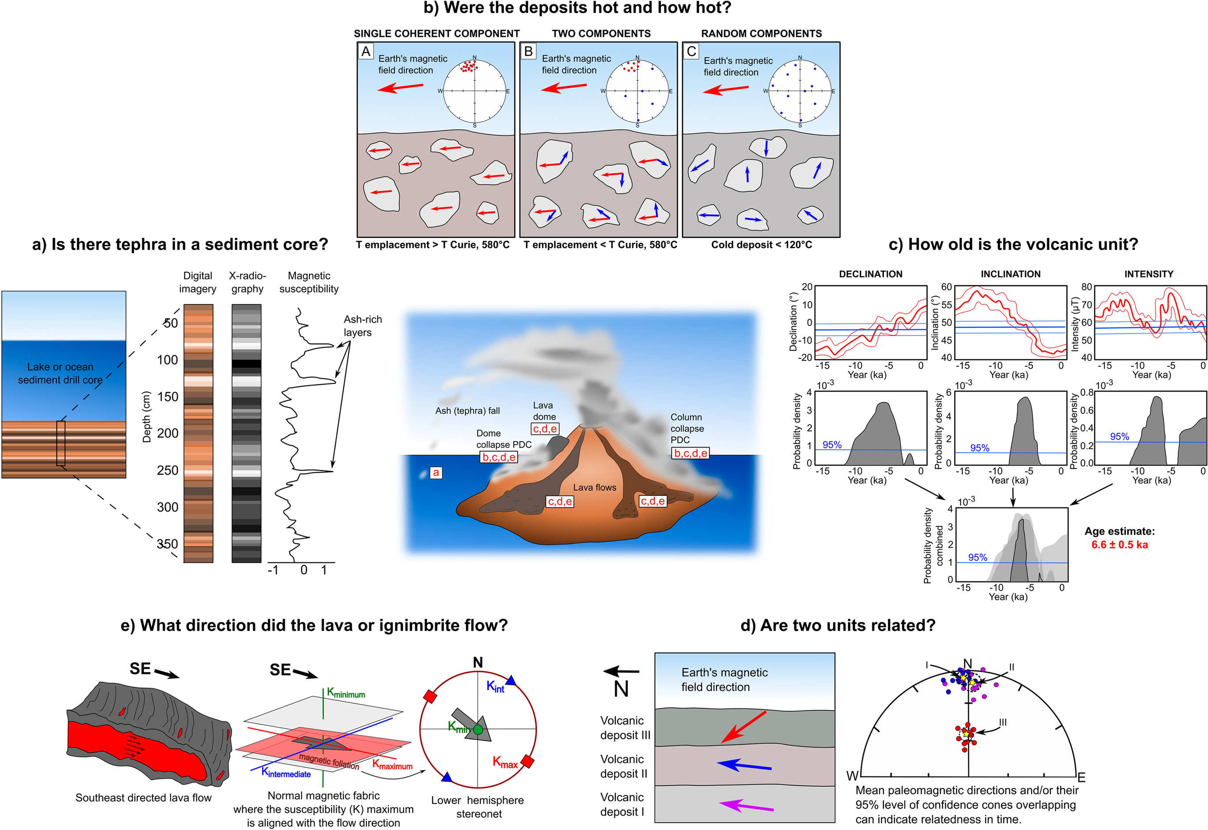

Slide 52
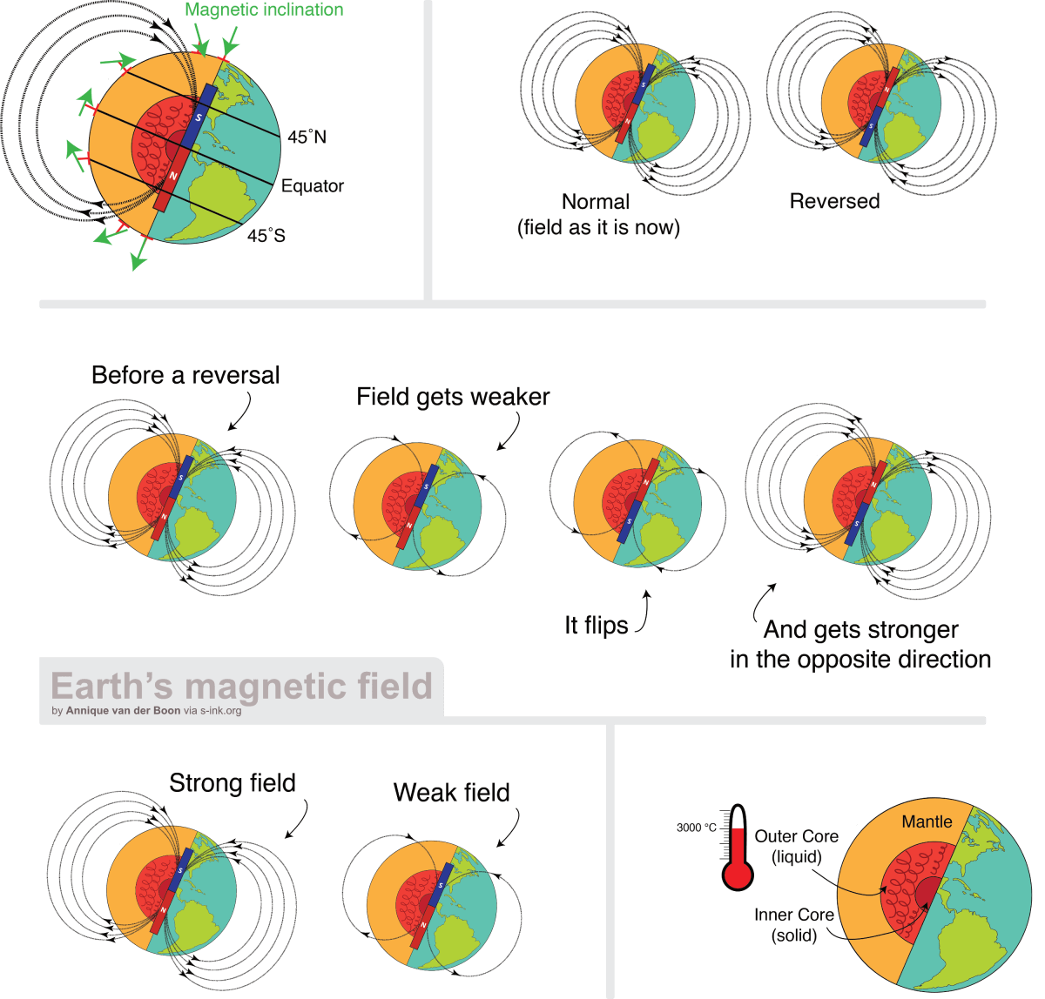
Geocentric Axial Dipole

Slide 53
In GAD we trust

Slide 54

But wait, it isn’t so easy!
Primary Remnant magnetisation: When a rock forms, it may acquire a magnetization parallel to the ambient magnetic field referred to as primary
Secondary remanent magnetisation: reheated, takes on new directions
Reverse magnetisation: direction opposite to that of the present Earth's magnetic field
Normal magnetisation: parallels the present field

Slide 55
Type | Name | Description
NRM | Natural remanent magnetization | The remanent magnetization (RM) that a sample possess in natural conditions is the addition of all magnetic remanence components of a rock/sediment
ChRM | Chemical RM | The acquired RM during a chemical interphase exchange or formation of new minerals (diagenesis, burial, metamorphism)
DRM | Detrital RM | The acquired RM during deposition, the minerals are detrital particles from somewhere else
PDRM | Post deposit RM | The acquired DRM may undergo additional changes (i.e., shallowing) after deposition but before final compaction
VRM | Viscous RM | The acquired RM during a long period of time in a weak external magnetic field. This process usually affects shallow buried rocks affected by very low temperatures
IRM | Isothermal RM | The acquired RM during a short period of time at a certain temperature in a strong external magnetic. In nature, this only happens in relation to lightning, blasting, or meteoritic impacts
TRM | Thermoremanent M | The RM acquired for a mineral below the Curie/Néel temperature. Given the high temperatures of most ferromagnetic minerals, this mechanism affects igneous or high-temperature metamorphic rocks
Notes:
Paleomagnetism in Structural Geology and Tectonics | SpringerLink

Slide 56
There are many ways to peel an orange.

Slide 57
PalaeoMag and Plate Reconstruction.
Apparent Polar Wander
Euler Poles
True Polar Wander

Slide 58
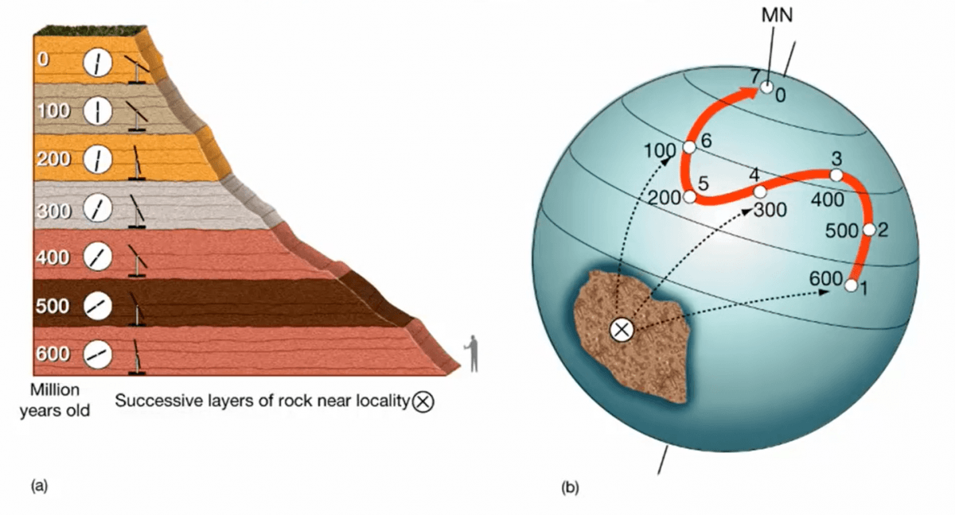
Apparent Polar Wander

Slide 59
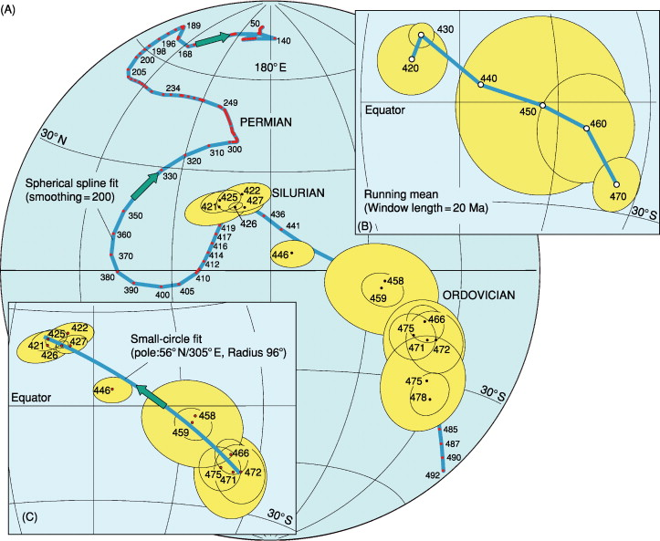

Slide 60
Euler poles to create the APW
Definition: Euler’s fixed point theorem states that any motion of a rigid body on the surface of a sphere may be represented as a rotation about an appropriately chosen rotation pole, called an Euler pole.
For us: What happens at a boundary between two plates depends on the direction of the motion and the orientation of the boundary
These create relative motion

Slide 61

Notes:
Don’t worry, it remains part of rocket science.

Slide 62
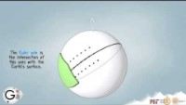
Notes:
https://www.youtube.com/watch?v=_0mdH8NtJXE

Slide 63
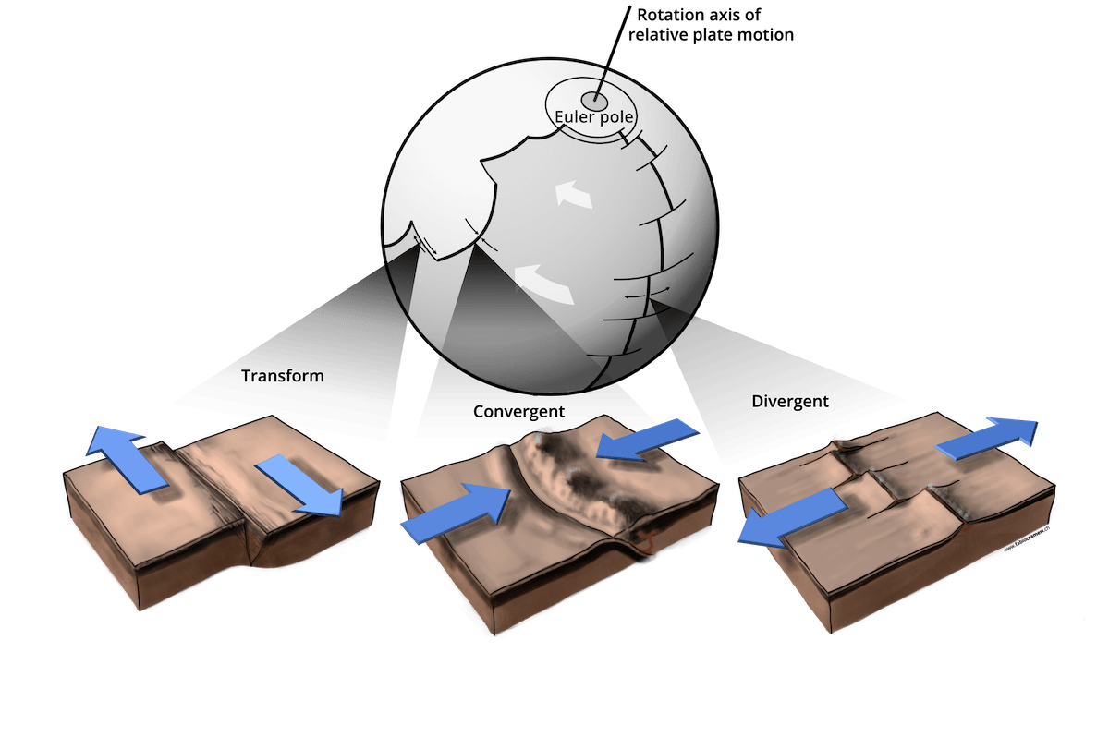
More than lines: results in rock
Notes:
Illustration of how plates move across the Earth. The motion of (almost) rigid surface portions on a sphere can be described by a rotation around a rotation axis, which cuts the surface at the so-called Euler pole. This relative motion of the plates is mainly accommodated by localised deformation at plate boundaries. Three general types of plate boundaries exist: transform plate boundaries allow the plates to move alongside each other, and convergent and divergent plate boundaries allow for plate destruction and creation, respectively. Transform and divergent plate boundaries are almost straight features, but spreading ridges are generally offset laterally by transform intersections. Subduction zones are usually arcuate (i.e., concave toward the upper plate) due to interaction with mantle flow. Variations of these plate boundaries exist depending on the given combination of upper and lower plate nature (i.e., continental or oceanic).
Creator: Fabio Crameri
This version: 23.08.2021
License: Attribution-ShareAlike 4.0 International (CC BY-SA 4.0)
Specific citation: This graphic by Fabio Crameri from Crameri et al. (2019) is available via the open-access s-Ink repository.
Related reference: Crameri, F., G.E. Shephard, and C.P. Conrad, (2019), Plate Tectonics☆, Reference Module in Earth Systems and Environmental Sciences, Elsevier, doi:10.1016/B978-0-12-409548-9.12393-0

Slide 64
Palaeomagnetics Euler poles Lithology Slab dynamics Spreading rates LLSVP

Slide 65
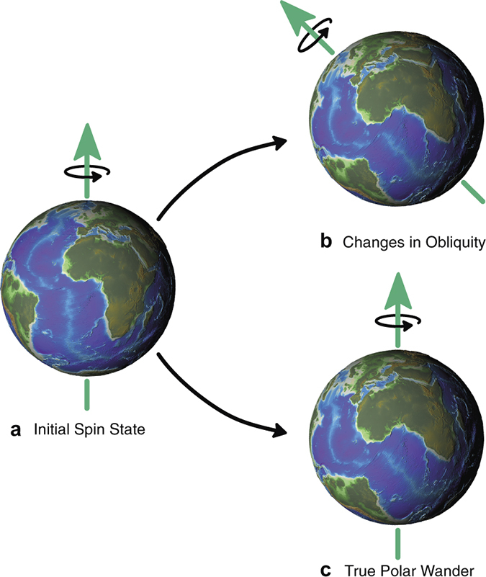
True Polar Wander
Notes:
Comparison of plate motions assuming a fixed hotspot framework indicates that TPW has amounted to about 12° since the Early Tertiary. Because TPW affects equally all calculated poles of a given age in the same way, however, it does not usually influence relative plate motions deduced from APW paths.

Slide 66
True Polar Wander
TPW results from changes in the magnetic pole position caused by global slip at the core-mantle boundary, at least in part in response to changes in mass redistribution at the surface caused by the formation and breakup of supercontinents. Movement of the entire lithosphere with respect to the mantle or of the mantle relative to the core can produce the same effect.
Notes:
Comparison of plate motions assuming a fixed hotspot framework indicates that TPW has amounted to about 12° since the Early Tertiary. Because TPW affects equally all calculated poles of a given age in the same way, however, it does not usually influence relative plate motions deduced from APW paths.

Slide 67
True Polar Wander
Formal definition:
As defined as the migration of the maximum moment of inertia (I_{max}) to. align with Earth’s spin axis, TPW occurs as a rotation about an Euler pole controlled by the minimum moment of inertia (I_{min}) that is equatorial and is therefore predicted to circumscribe a great-circle APW path
Notes:
Comparison of plate motions assuming a fixed hotspot framework indicates that TPW has amounted to about 12° since the Early Tertiary. Because TPW affects equally all calculated poles of a given age in the same way, however, it does not usually influence relative plate motions deduced from APW paths.

Slide 68

True Polar Wander

Slide 69
Earth is a spinning ball in space.
Notes:
APW is earth relative.
TPW corrected for earths situation in the cosmos

Slide 70
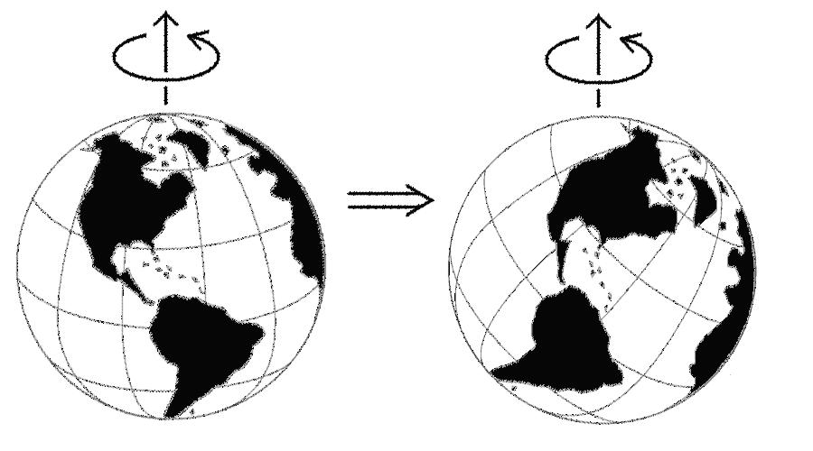
True Polar Wander: consider reconstruction
Notes:
The arrangement is the same. The latitudes are very different.

Slide 71
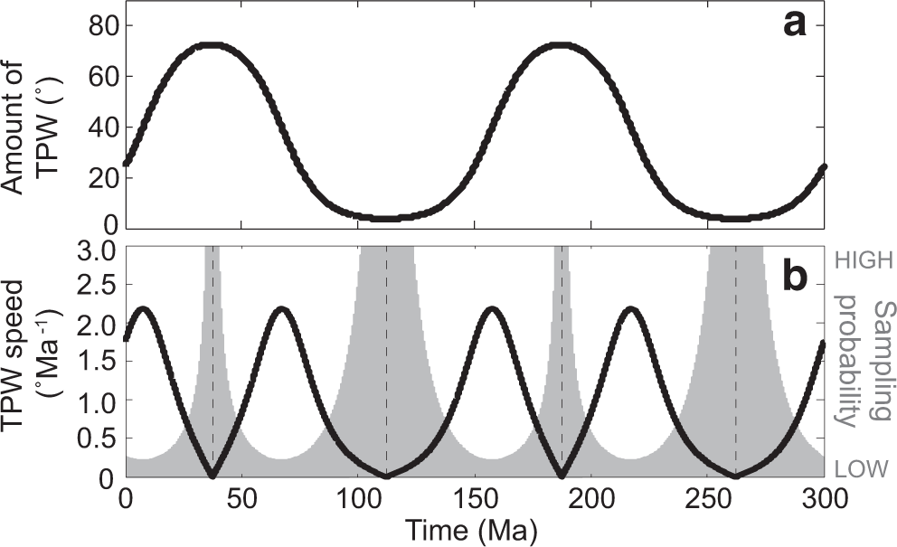
True Polar Wander: observable events
Jing et al 2022.
Notes:
a True polar wander (TPW) angle as a function of time with an initial condition of 25°. b TPW speed (black line) and probability function (shaded gray) as a function of time.
https://www.nature.com/articles/s41467-022-35609-3 TPW in the middle of the event. A simple simulation (Methods) demonstrates that it is 20 times less likely to sample TPW “in action” than the endpoints largely before/after the TPW event

Slide 72
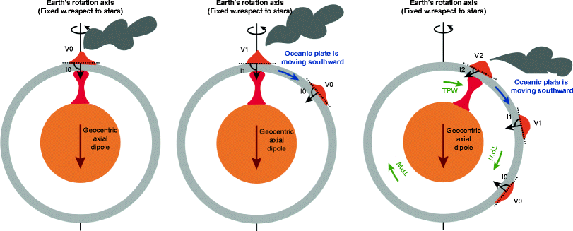
In GAD we trust

Slide 73
Q: Does TPW influence APW?

Slide 74
Q: Does TPW influence APW?
Q. What happens if we don’t account for TPW in our APW?

Slide 75
Q. Does TPW influence APW?
Q. What happens if we don’t account for TPW in our APW?
Q. What happens to our tectonic reconstructions?

Slide 76
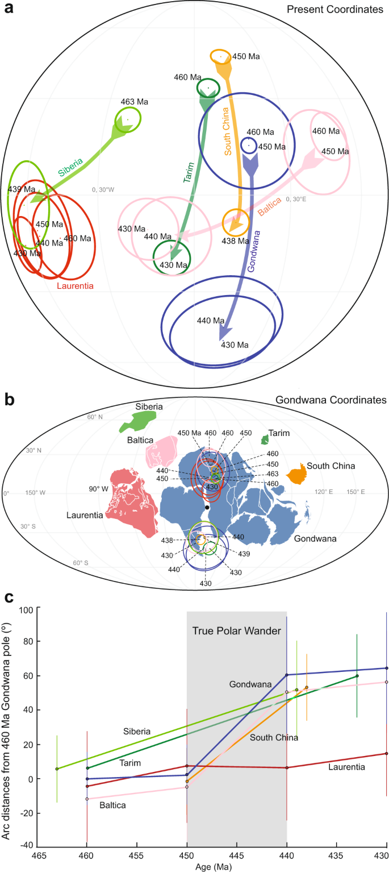
Jing et al 2022
Notes:
Ordovician–Silurian true polar wander as a mechanism for severe glaciation and mass extinction | Nature Communications

Slide 78
Notes:
Ordovician–Silurian true polar wander as a mechanism for severe glaciation and mass extinction | Nature Communications

Slide 79
Notes:
Ordovician–Silurian true polar wander as a mechanism for severe glaciation and mass extinction | Nature Communications

Slide 80
Break!
Notes:
APW is earth relative.
TPW corrected for earths situation in the cosmos

Slide 81
Picking your Plate:
Now you know about data from the mantle, from hotspots, from palaeomagnetics, from lithology, and celestial movements.
Can palaeontolgy be used?
3

Slide 82
Picking your Plate:
Now you know about data from the mantle, from hotspots, from palaeomagnetics, from lithology, and celestial movements.
Can palaeontolgy be used?
As the Earth's magnetic dipole field is radially symmetric, paleo-longitudinal information cannot be determined from paleomagnetic data alone unless further assumptions are made (Torsvik and Cocks, 2019).

Slide 83
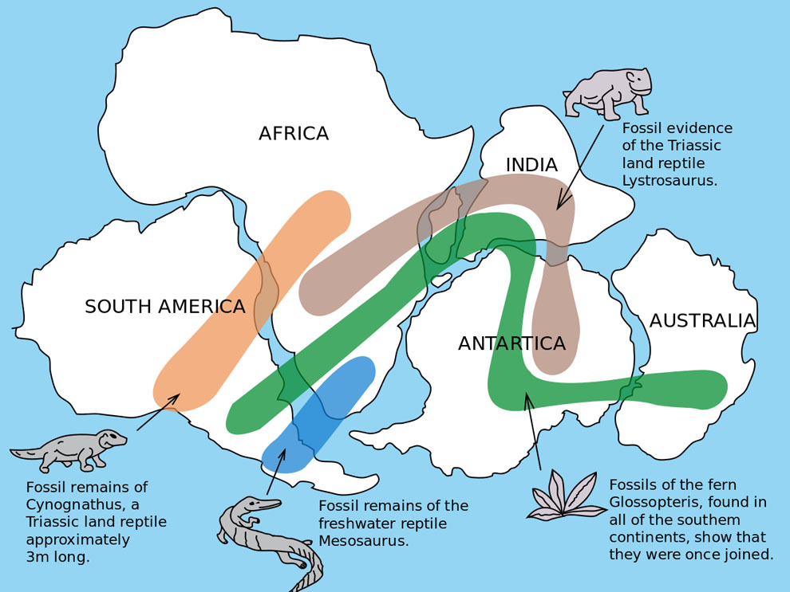
Q.

Slide 84
Picking your Plate:
Plate reconstruction reference frames
Hotspot/mantle
Palaeomagnetic
How to choose? A guide for palaeontolgists.

Slide 85
Hotspot: Mantle Reference 1.
Mantle reference frames use mantle features such as upwellings and subducted slabs as an absolute reference to plate motion.

Slide 86
Hotspot: Mantle Reference 1.
Mantle reference frames use mantle features such as upwellings and subducted slabs as an absolute reference to plate motion.
Q.

Slide 87
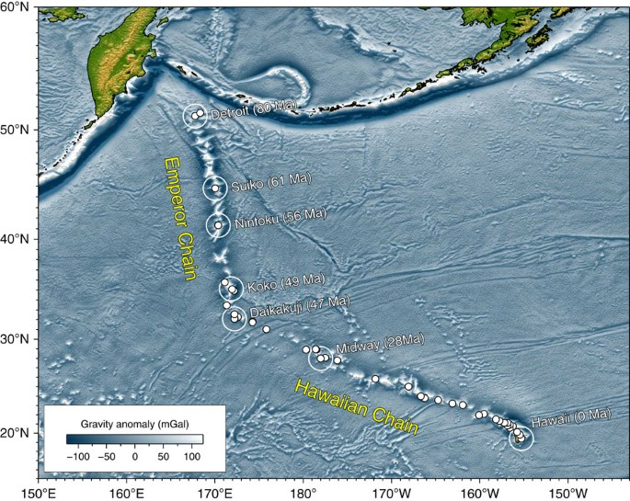

Slide 89
Notes:
Direction. Speed.

Slide 90
Hotspot data (MRF)
Only good for the last 100-125 ma
Why?
Duh.
Notes:
Is part of the mantle reference frame. Separated off because it is good ish for more recent times.

Slide 91
Ocean-plate age
Notes:
Maps of the age of oceanic plates, which varies between 0 and around 200 Ma due to ongoing plate motion and recycling (i.e., ocean-plate tectonics). Global ocean-plate age data from Müller et al. (1997) visualised on a custom Interrupted Mollweide map projection from Crameri et al. (2020) focussing on the World’s oceans. The Scientific colour map ‘batlow‘ is used to represent data accurately and to all readers.
Creator: Fabio Crameri
This version: 20.08.2021
License: Attribution-ShareAlike 4.0 International (CC BY-SA 4.0)
Specific citation: This graphic by Fabio Crameri from Crameri et al. (2022) is available via the open-access s-Ink.org repository.
Related references: Crameri, F., G.E. Shephard, and E.O. Straume (2022, Pre-print), Effective high-quality science graphics from s-Ink.org, EarthArXiv, https://doi.org/10.31223/X51P78 Müller, R. D., et al. (1997). “Digital isochrons of the world’s ocean floor.” J. Geophys. Res. 102(B2): 3211-3214. Crameri, F., V. Magni, M. Domeier, G.E. Shephard, K. Chotalia, G. Cooper, C. Eakin, A.G. Grima, D. Gürer, A. Király, E. Mulyukova, K. Peters, B. Robert, and M. Thielmann (2020), A transdisciplinary and community-driven database to unravel subduction zone initiation, Nature Communications, 11, 3750. doi:10.1038/s41467-020-17522-9

Slide 92
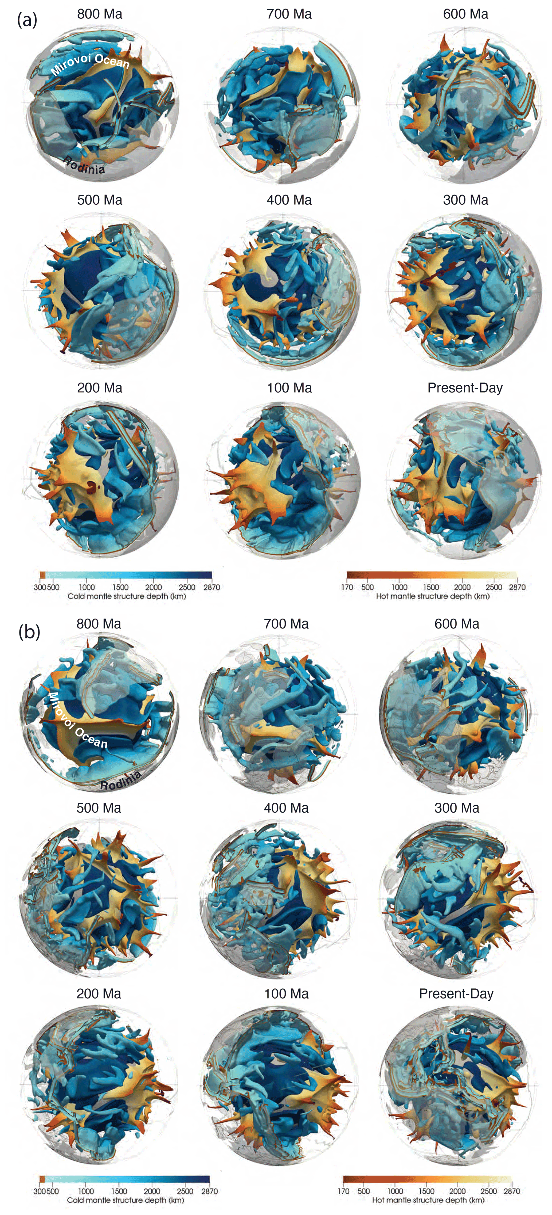
Mantle reference frame
Hotspot r frames = mantle r frames.
Motions of the plates relative to the mantle not the spin axis.
Notes:
Visualization of modelled mantle structure through time focussing on the Pacific hemisphere since 800 Ma in 100 Myr intervals with central meridians at 270 (a) and 150∘ E (b). Mantle hotter than the layer average by the non-dimensional value of 0.1 (305 K) is shown in orange, while mantle colder than the layer average by the non-dimensional value of −0.05 (153 K) is shown in blue, highlighting anomalously hot and cold mantle structures largely corresponding to upwellings and subducting slabs, respectively. SE - A tectonic-rules-based mantle reference frame since 1 billion years ago – implications for supercontinent cycles and plate–mantle system evolution (copernicus.org)

Slide 93
Mantle reference frame
Hotspot frames are mantle frames.
Motions of the plates relative to the mantle not the spin axis.
Unlike the spin axis, the convecting mantle does not provide a stable, fixed reference system through time. A mantle reference frame attempts to isolate the motions of plates relative to the mantle, given as plate rotations relative to the Earth's spin axis, which is assumed to be fixed.
Notes:
Visualization of modelled mantle structure through time focussing on the Pacific hemisphere since 800 Ma in 100 Myr intervals with central meridians at 270 (a) and 150∘ E (b). Mantle hotter than the layer average by the non-dimensional value of 0.1 (305 K) is shown in orange, while mantle colder than the layer average by the non-dimensional value of −0.05 (153 K) is shown in blue, highlighting anomalously hot and cold mantle structures largely corresponding to upwellings and subducting slabs, respectively. SE - A tectonic-rules-based mantle reference frame since 1 billion years ago – implications for supercontinent cycles and plate–mantle system evolution (copernicus.org)

Slide 94
Mantle reference frame
Hotspot frames are mantle frames.
Motions of the plates relative to the mantle not the spin axis.
Unlike the spin axis, the convecting mantle does not provide a stable, fixed reference system through time. A mantle reference frame attempts to isolate the motions of plates relative to the mantle, given as plate rotations relative to the Earth's spin axis, which is assumed to be fixed.
Notes:
Visualization of modelled mantle structure through time focussing on the Pacific hemisphere since 800 Ma in 100 Myr intervals with central meridians at 270 (a) and 150∘ E (b). Mantle hotter than the layer average by the non-dimensional value of 0.1 (305 K) is shown in orange, while mantle colder than the layer average by the non-dimensional value of −0.05 (153 K) is shown in blue, highlighting anomalously hot and cold mantle structures largely corresponding to upwellings and subducting slabs, respectively. SE - A tectonic-rules-based mantle reference frame since 1 billion years ago – implications for supercontinent cycles and plate–mantle system evolution (copernicus.org)

Slide 95
Mantle convection (mobile-lid)
Notes:
Movie showing the temporal evolution of a global, fully spherical, 3D model of whole-mantle convection with hot temperature isosurface (red) and stiff viscosity isosurfaces (grey).
Creator: Fabio Crameri
This version: 07.08.2021
License: Attribution-ShareAlike 4.0 International (CC BY-SA 4.0)
Specific citation: This graphic by Fabio Crameri from Crameri and Tackley (2016) is available via the open-access s-Ink.org repository.
Related reference: Crameri, F., and P. J. Tackley (2016), Subduction initiation from a stagnant lid and global overturn: new insights from numerical models with a free surface, Progress in Earth and Planetary Science, 3(1), 1–19, doi:10.1186/s40645-016-0103-8

Slide 96
Muller et al 2022
Notes:
Visualization of modelled mantle structure through time focussing on the Pacific hemisphere since 800 Ma in 100 Myr intervals with central meridians at 270 (a) and 150∘ E (b). Mantle hotter than the layer average by the non-dimensional value of 0.1 (305 K) is shown in orange, while mantle colder than the layer average by the non-dimensional value of −0.05 (153 K) is shown in blue, highlighting anomalously hot and cold mantle structures largely corresponding to upwellings and subducting slabs, respectively. https://se.copernicus.org/articles/13/1127/2022/

Slide 97
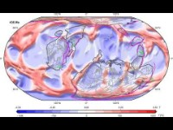

Slide 98
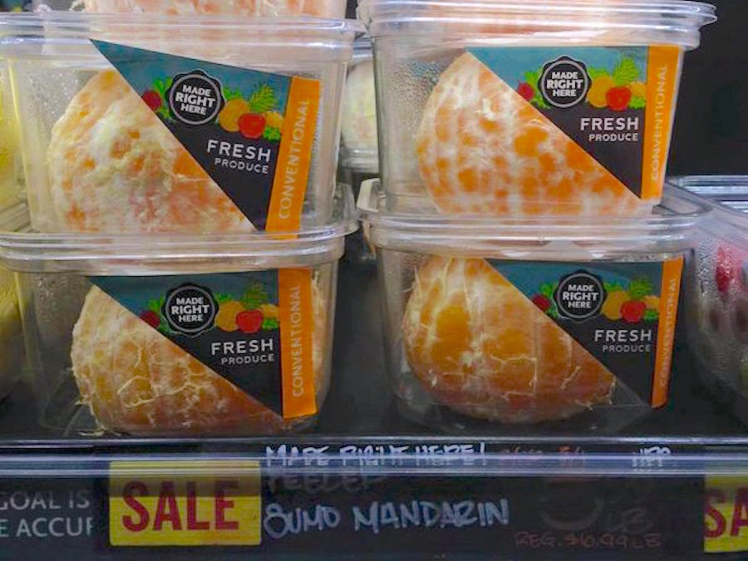

Slide 100
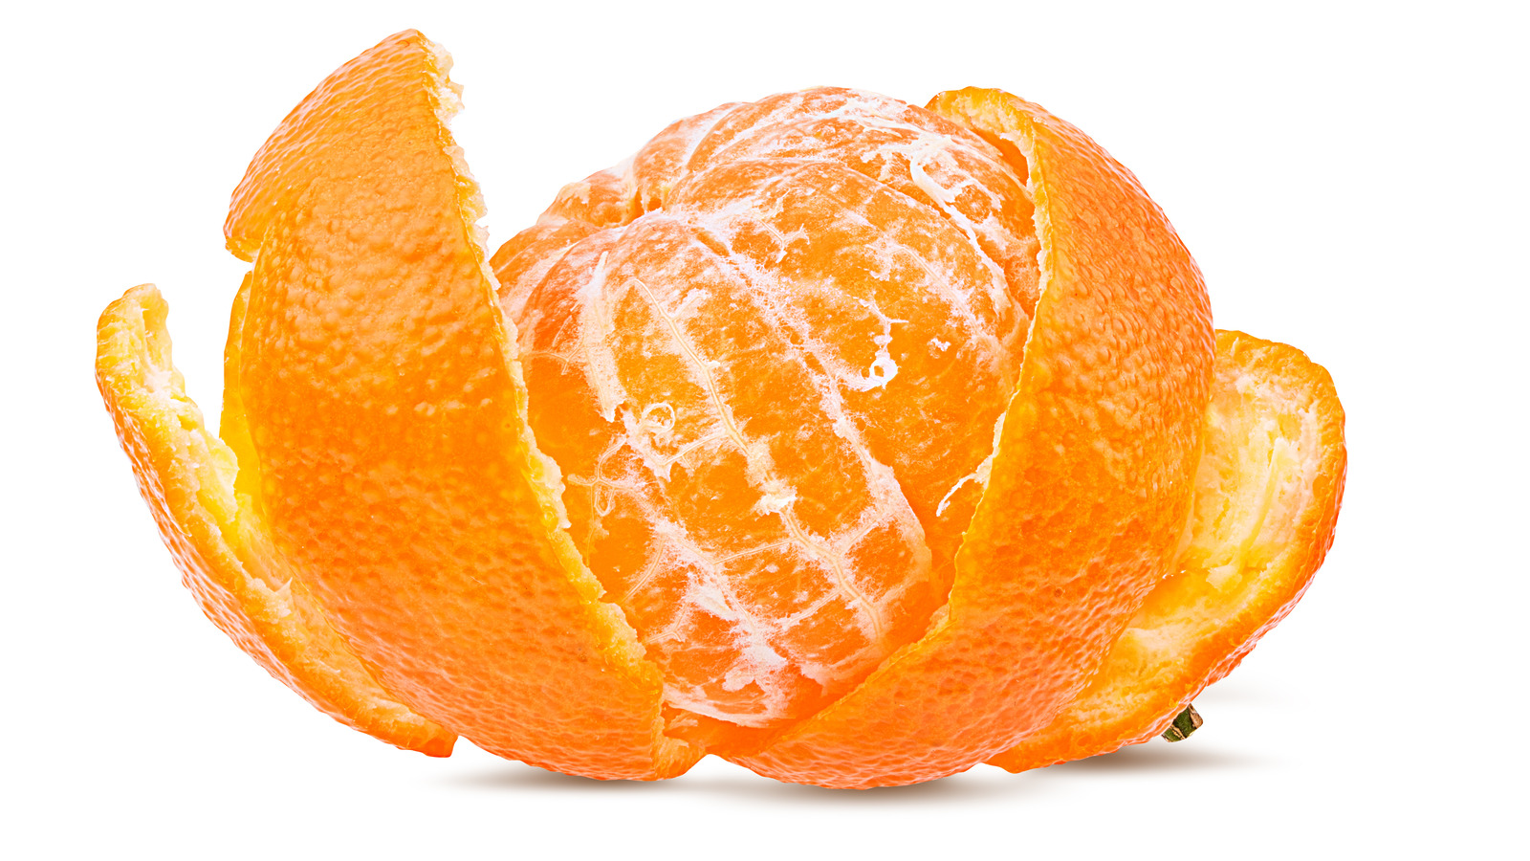

Slide 101
Mantle reference frame
Often, to account for the plate velocity artefacts that occur when integrating TPW data with mantle reference frame, the method reduces the surface rotation to 0 or near zero.

Slide 102
MFR is Used for what? For understanding the mantle!
History of plume-related volcanism
plumes are associated with evolving basal mantle structures
MFR is a mechanistic approach to plate arrangement
Both the paleo-latitude of a plate and its paleo-meridian orientation can be calculated using paleomagnetic data, providing a paleomagnetic pole for a given plate (Cox and Hart, 2009).

Slide 103
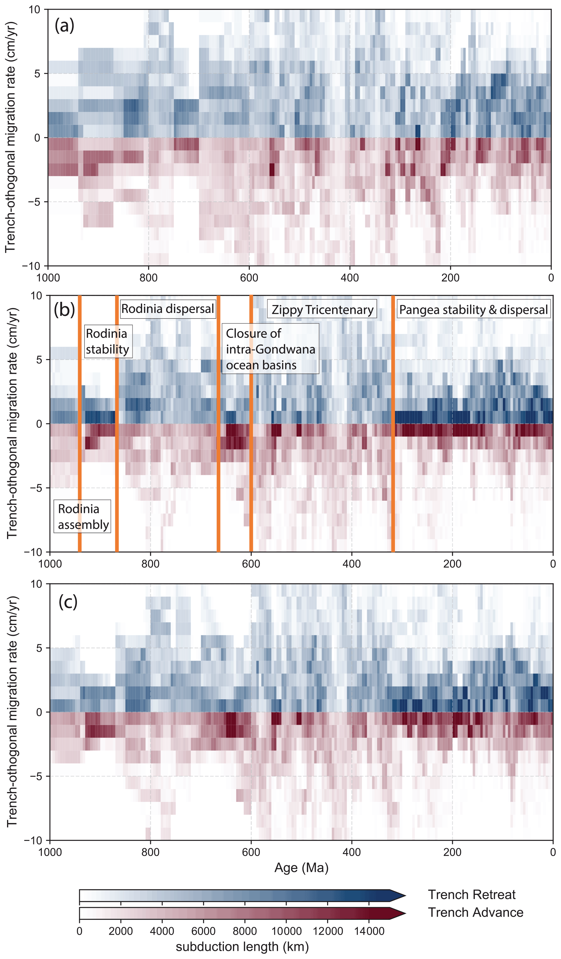
A = Palaeomag RF
C, B are Mantle RF
Notes:
Figure 5Histogram of the trench-orthogonal overriding plate speed for (a) the plate motion model from Merdith et al. (2021), (b) the same model with net lithospheric rotation removed, and (c) our optimized mantle reference frame. Colours are proportional to the length of subduction zones, which are either retreating (blue) or advancing (red) at a given rate. Both the no-net-rotation and optimized models limit the occurrence of unreasonably fast trench retreat or advance.

Slide 104
MFR is Used for what? For understanding the mantle!
History of plume-related volcanism
plumes are associated with evolving basal mantle structures
MFR is a mechanistic approach to plate arrangement
Both the paleo-latitude of a plate and its paleo-meridian orientation can be calculated using paleomagnetic data, providing a paleomagnetic pole for a given plate (Cox and Hart, 2009).
However, since the Earth's magnetic dipole field is radially symmetric, paleo-longitudinal information cannot be determined from paleomagnetic data alone unless further assumptions are made (Torsvik and Cocks, 2019).

Slide 105
Palaeomagnetic reference frame
The PRF relies on the Geocentric Axial Dipole
Uses palaeomagnetic data for latitude
Uses Apparent Polar Wander for relative movements and displacement
Adjusts for True Polar Wander

Slide 106
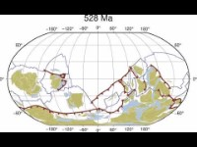
Notes:
Merdith et al 2021.

Slide 107
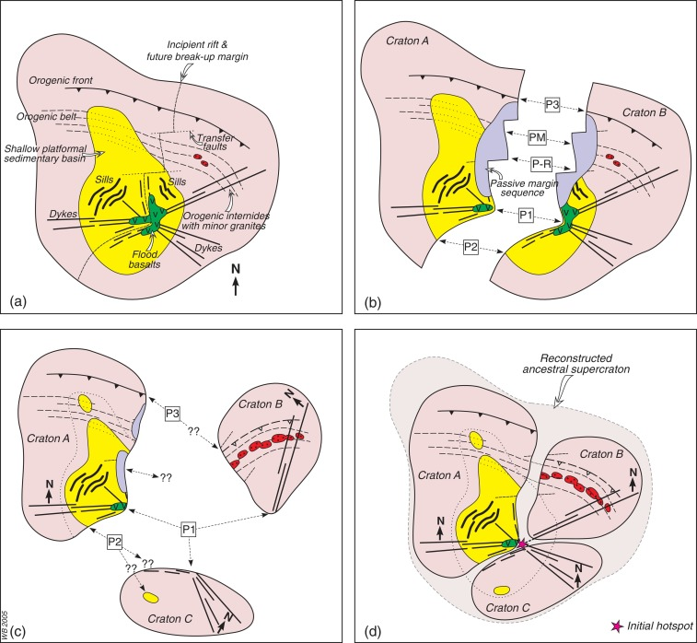
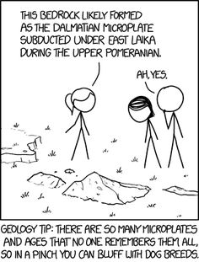
Other data

Slide 108
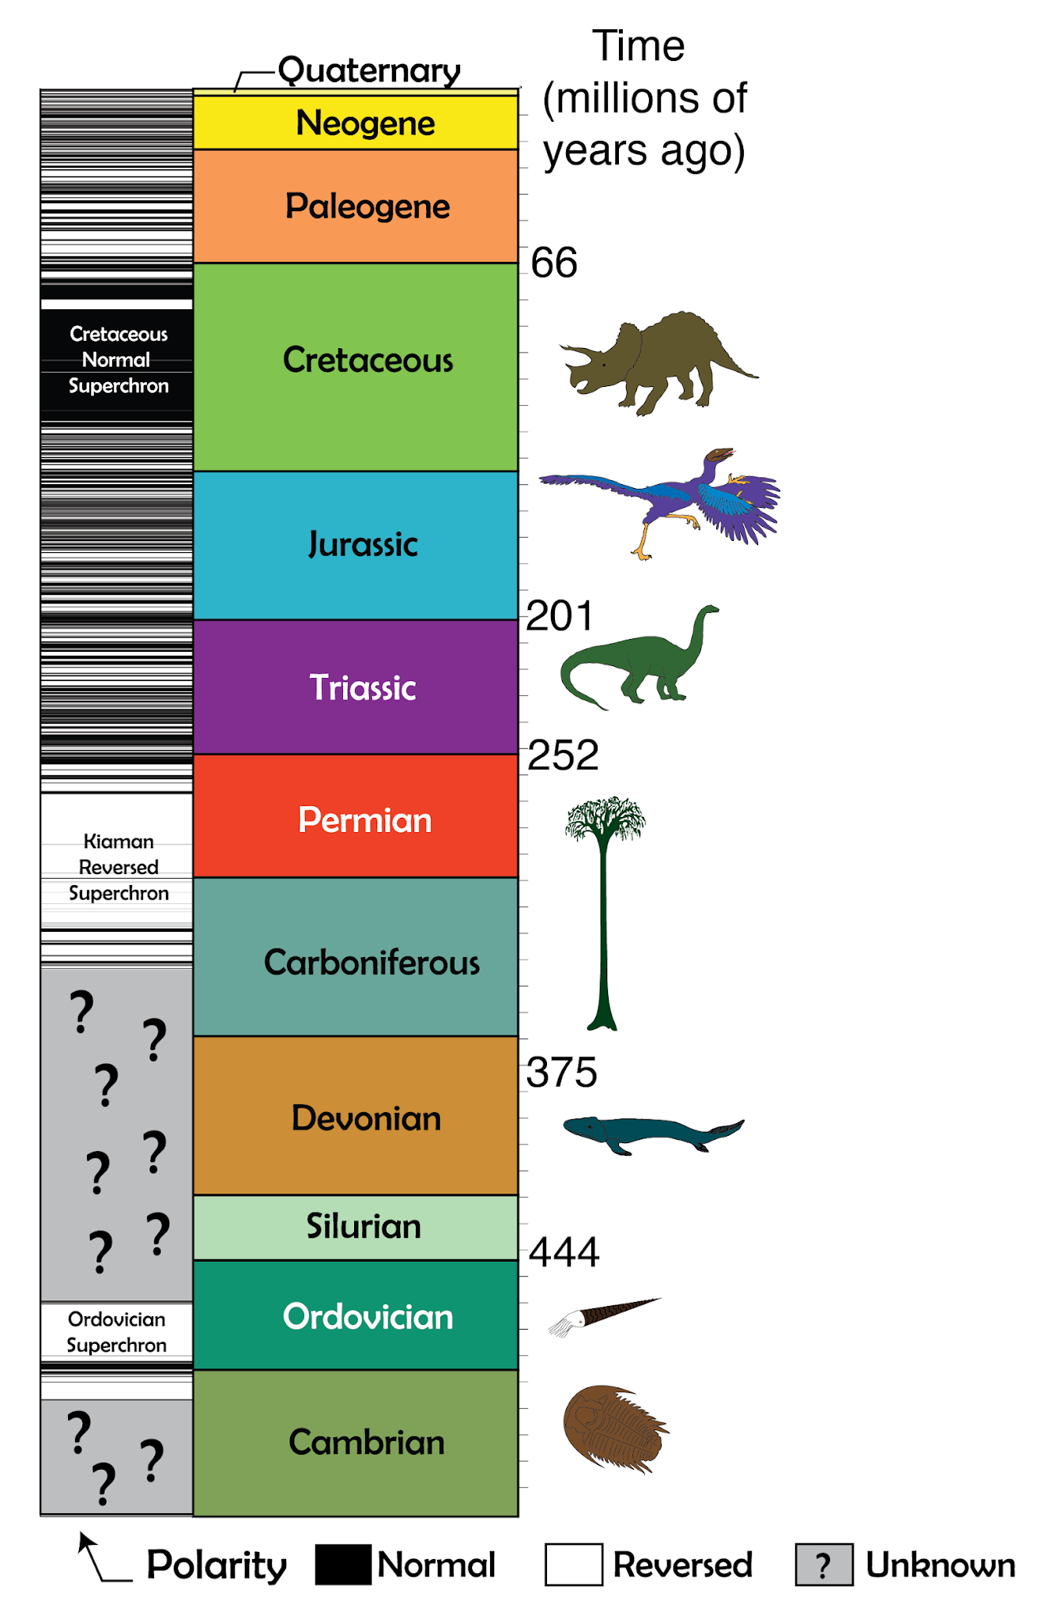
The History
Notes:
Frontiers | The Cretaceous Normal Superchron: A Mini-Review of Its Discovery, Short Reversal Events, Paleointensity, Paleosecular Variations, Paleoenvironment, Volcanism, and Mechanism (frontiersin.org) Do superchrons occur without any palaeomagnetic warning? - ScienceDirect

Slide 109
Things get unreliable at around 185-125ma.
CNS, the Kaiman, LLSVPS and the Superchron?
Can we still use PMRF? Yes.
In GAD we trust
(Geocentric Axial Dipole)

Slide 110
Deep Time
1) geomagnetic polarity reversals are rapid, globally synchronous events, and lend themselves well to global, time-significant correlations; (2) polarity reversals are not predictable and yield unique reversal patterns; (3) significant parts of the GPTS have been astronomically tuned, intercalibrated with detailed biostratigraphy, and/or constrained with absolute radiometric ages.
Notes:
https://doi.org/10.1016/B0-12-369396-9/00103-9

Slide 111
Normal or reversed pole
For an isolated paleopole, it is not possible to tell if the pole is reversed or normal. This decision must be based on other information such as paleoclimatic data or an APW path constructed from other geographic localities, but including the age of the measured sample.
??? There must be plenty of good data. Does the Cambrian and Devonian have that???
Notes:
https://www.sciencedirect.com/science/article/pii/S001282522200157X#f0120

Slide 112
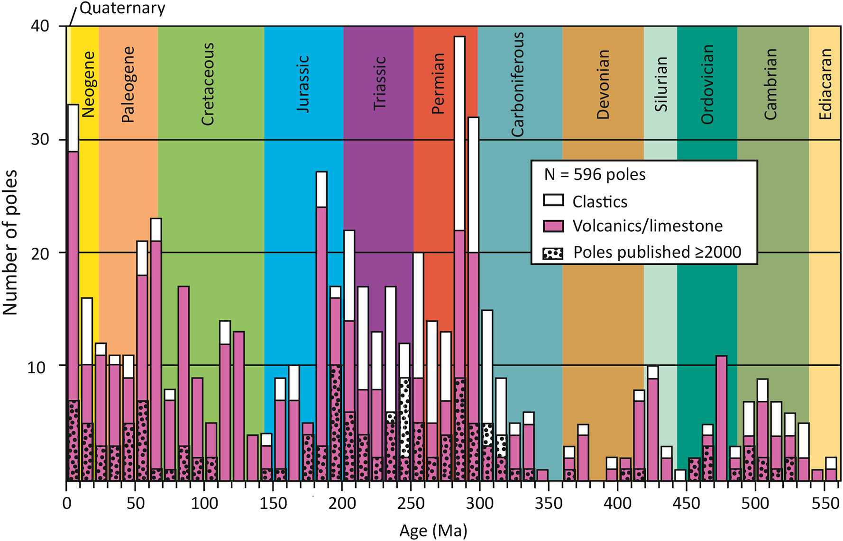
Weak palaeomagnetic field

Slide 113
Why the Kaiman so bad for us and not the CNS?

Slide 114
Why the Kaiman so bad for us and not the CNS?
No seafloor older than 200Ma
We lose an entire set of data
Overprinting

Slide 115
How old can we go? The Ediacaran problem
Weak palaeomagnetic field.
We almost lost our magnetic field in the EDIACARAN.
CORE NUCLEATION?
Notes:
https://www.sciencedirect.com/science/article/pii/S1342937X16000319

Slide 116
How old can we go? The Ediacaran problem
Weak palaeomagnetic field.
We almost lost our magnetic field in the EDIACARAN.
CORE NUCLEATION?
But why again in the Devonian? The core can only form once.
Notes:
https://www.sciencedirect.com/science/article/pii/S1342937X16000319

Slide 117
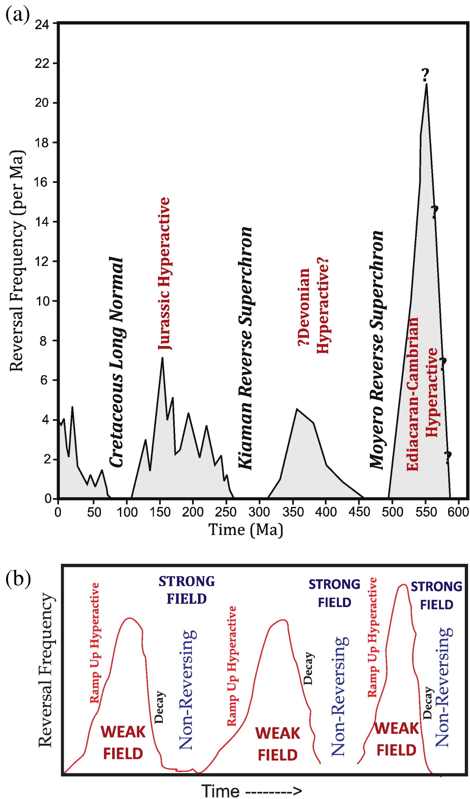

Meert et al 2016
Notes:
https://www.sciencedirect.com/science/article/pii/S1342937X16000319#f0025

Slide 118
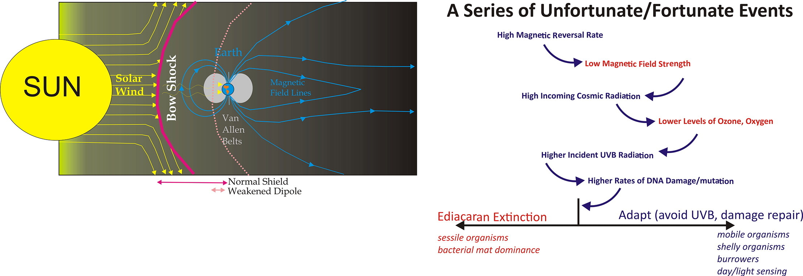
Implications for life?

Slide 119
Notes:
Merdith et al 2021.

Slide 120

Uniting both MRF and PMRF.

Slide 121
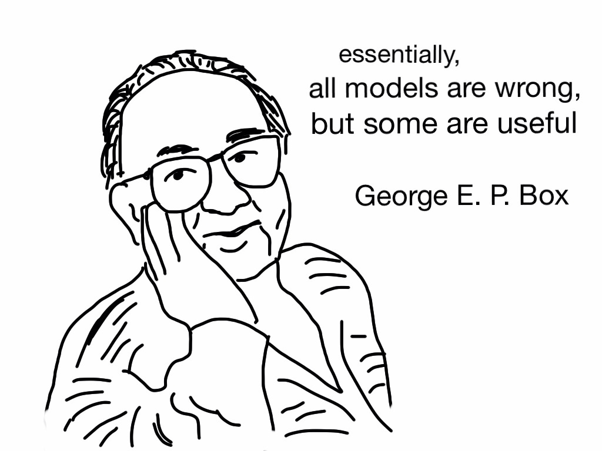

Slide 122
The way you think about a problem will ALWAYS impact the product.

Slide 123
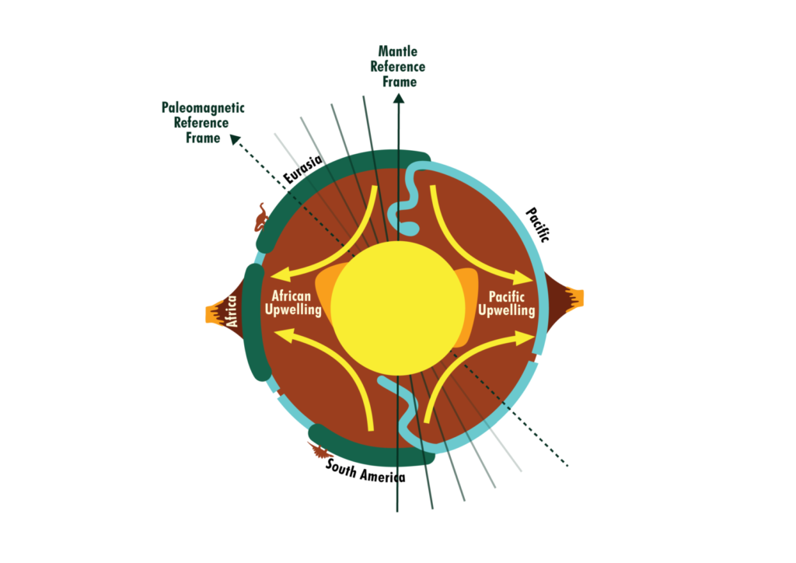
The PMRF has problems
The MRF has problems
Notes:
Mantle reference frames use mantle features such as upwellings and subducted slabs as an absolute reference to plate motion. These reference frames do not always reflect the true position of past continents as they neglect true polar wander. This is shown in the figure with the implied spin axis of the Earth in a mantle frame actually in a different place in the paleomagnetic frame due to a shifting of the plate-mantle system relative to the core. Image by Rachel O’Brien and based on Conrad et al, 2013.

Slide 124
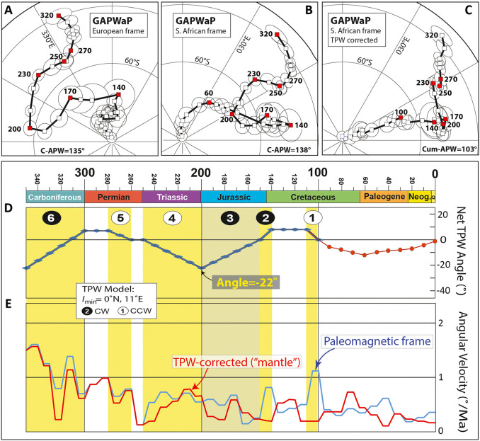
DEBATE TIME
Notes:
Torsvik and cocks 2021

Slide 125

There is an answer! (For now.)

Slide 126
MANTLE VS PALAEOMAG
MRF is agnostic of TPW. Paleomagnetic data record information informing both the motions of the plates relative to the mantle and TPW, and they can thus be used to restore the plates in terms of their “true” latitudinal positions through time, which is useful for paleoclimate studies.

Slide 127
MANTLE VS PALAEOMAG
MRF is agnostic of TPW. Paleomagnetic data record information informing both the motions of the plates relative to the mantle and TPW, and they can thus be used to restore the plates in terms of their “true” latitudinal positions through time, which is useful for paleoclimate studies.
However, reconstructed paleomagnetic poles derived from paleomagnetic data cannot constrain paleo-longitude due to the radial symmetry of the Earth's magnetic field (Cox and Hart, 2009) and therefore cannot be used to accurately track the east–west movement of the plates across mantle upwellings and downwellings unless additional assumptions are made – see Sect. 1.2 in Torsvik and Cocks (2019).

Slide 128
MANTLE VS PALAEOMAG
MRF is agnostic of TPW. Paleomagnetic data record information informing both the motions of the plates relative to the mantle and TPW, and they can thus be used to restore the plates in terms of their “true” latitudinal positions through time, which is useful for paleoclimate studies.
However, reconstructed paleomagnetic poles derived from paleomagnetic data cannot constrain paleo-longitude due to the radial symmetry of the Earth's magnetic field (Cox and Hart, 2009) and therefore cannot be used to accurately track the east–west movement of the plates across mantle upwellings and downwellings unless additional assumptions are made – see Sect. 1.2 in Torsvik and Cocks (2019).
In contrast, an ideal mantle reference frame provides constraints on both paleo-latitudes and paleo-longitudes of plates relative to the mantle.
However, as it does not consider TPW, it does not provide paleogeographic reconstructions useful for paleoclimate studies (Van Hinsbergen et al., 2015).

Slide 129
MANTLE VS PALAEOMAG
MRF is agnostic of TPW. Paleomagnetic data record information informing both the motions of the plates relative to the mantle and TPW, and they can thus be used to restore the plates in terms of their “true” latitudinal positions through time, which is useful for paleoclimate studies.
However, reconstructed paleomagnetic poles derived from paleomagnetic data cannot constrain paleo-longitude due to the radial symmetry of the Earth's magnetic field (Cox and Hart, 2009) and therefore cannot be used to accurately track the east–west movement of the plates across mantle upwellings and downwellings unless additional assumptions are made – see Sect. 1.2 in Torsvik and Cocks (2019).
In contrast, an ideal mantle reference frame provides constraints on both paleo-latitudes and paleo-longitudes of plates relative to the mantle.
However, as it does not consider TPW, it does not provide paleogeographic reconstructions useful for paleoclimate studies (Van Hinsbergen et al., 2015).

Slide 130

True Polar Wander: a reminder
Notes:
https://youtu.be/UEEFlmxVh94

Slide 131
Why is TPW so important for Palaeontologists?
Notes:
Geodynamics | Why plate tectonic reference frames are important? (egu.eu)
Abstract EGU23-10673 (copernicus.org)

Slide 132
Why is TPW so important for Palaeontologists?
Different reference frames can result in different average global temperatures of up to 1 degree Celsius at certain times.
Notes:
Geodynamics | Why plate tectonic reference frames are important? (egu.eu)
Abstract EGU23-10673 (copernicus.org)

Slide 133
Why is TPW so important for Palaeontologists?
Different reference frames can result in different average global temperatures of up to 1 degree Celsius at certain times.
Exact location of a data point (e.g. a fossil) in different reference frames could differ by over 15 degrees latitude
Notes:
Geodynamics | Why plate tectonic reference frames are important? (egu.eu)
Abstract EGU23-10673 (copernicus.org)

Slide 134
Why is TPW so important for Palaeontologists?
Different reference frames can result in different average global temperatures of up to 1 degree Celsius at certain times.
Exact location of a data point (e.g. a fossil) in different reference frames could differ by over 15 degrees latitude
These changes lead to have average annual temperatures that vary by over 20 °C between reference frames.
Notes:
Geodynamics | Why plate tectonic reference frames are important? (egu.eu)
Abstract EGU23-10673 (copernicus.org)

Slide 135
Why is TPW so important for Palaeontologists?
Different reference frames can result in different average global temperatures of up to 1 degree Celsius at certain times.
Exact location of a data point (e.g. a fossil) in different reference frames could differ by over 15 degrees latitude
These changes lead to have average annual temperatures that vary by over 20 °C between reference frames.
These differences tend to be around mid-latitudes, where a slight change in latitude often results in very different wind directions.
Notes:
Geodynamics | Why plate tectonic reference frames are important? (egu.eu)
Abstract EGU23-10673 (copernicus.org)

Slide 136

Let’s look at them
Muller et al 2022
Notes:
Plate reconstructions based on alternative approaches for modelling absolute plate motions, with reference frames based on paleomagnetic data (PMAG) (Merdith et al., 2021), no-net-rotation (NNR), tectonic-rules-based optimization (OPT), orthoversion from Cao et al. (2021a) following Mitchell et al. (2012), and a combination of paleomagnetic data and aligning LIPs with the edges of LLSVPs assumed to be stationary (Torsvik and Cocks, 2019), covering the time period from 200–900 Ma. The reconstruction of Torsvik and Cocks (2019) does not extend back to 600 Ma and older. Continents are outlined in beige, while subduction zones are toothed black lines. The present-day position of continents is shown in light grey in the background as a reference. SE - A tectonic-rules-based mantle reference frame since 1 billion years ago – implications for supercontinent cycles and plate–mantle system evolution (copernicus.org)

Slide 137

Ortho

Slide 138

OTP
400 Ma
Merdith et al 2021
Muller et al 2022

Slide 139
Merdith et al 2021
Torsvik and Cocks 2019

Slide 140


Slide 141
Building deep time earth: A Devonian Example

Slide 142


Slide 143
For Windows
C:\Program Files\Gplates\GPlates2.3.0\GeoData\
For Macs
GPlates installed into applications

Slide 144

Notes:
https://ponungeologentuvida.files.wordpress.com/2014/02/geologc3ada-de-la-tierra-media.pdf

